Slide 1
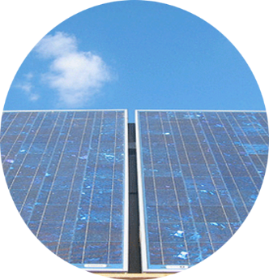


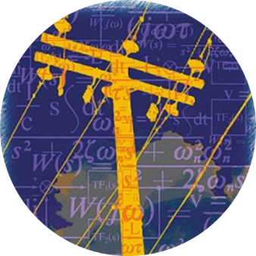
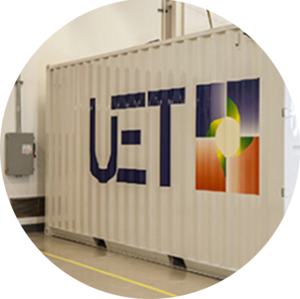

Solar
Materials
Storage
Accelerating the creation of a scalable, clean energy future
Notes:
The Clean Energy Institute is a research group at the University of Washington. We are trying to increase the use of clean energy in Washington and the world.

Slide 2
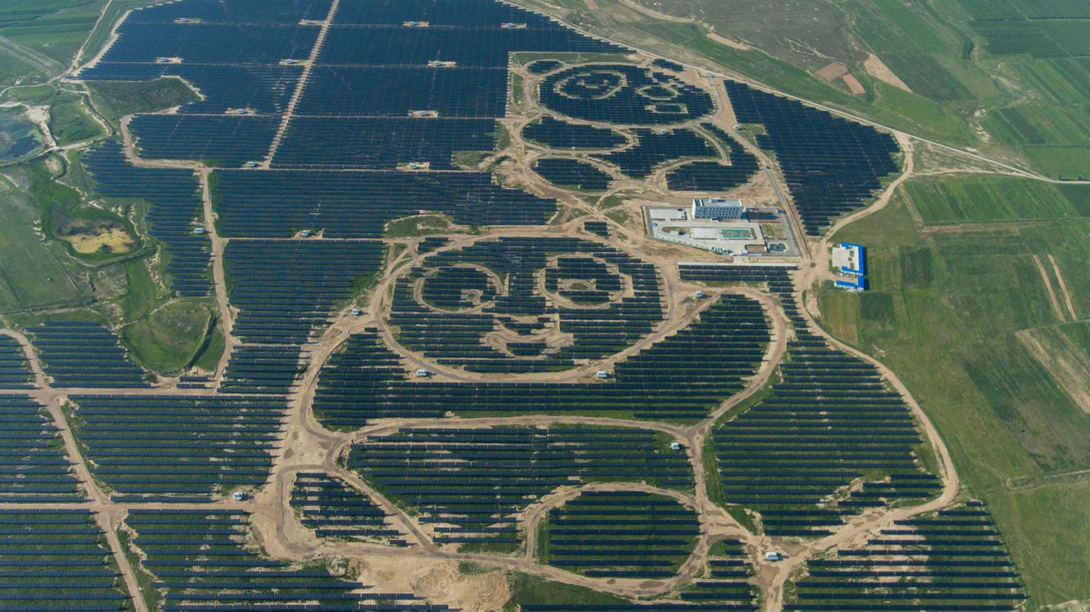
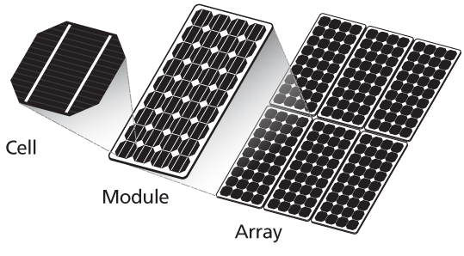
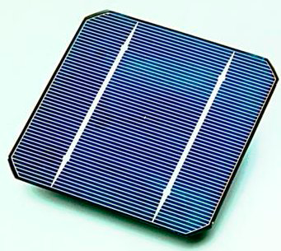
Solar energy & Solar cells
usually glass
protective layer
n-layer
semiconductors
junction
p-layer
Notes:
-top left image: solar array in China
-Solar cell is made of 3 parts:
Protective layer – usually glass, must be transparent
n-layer – semiconductor rich in electrons
p-layer – semiconductor deficient in electrons
Junction represents where n- and p-layers touch
-images via Phys.org and the BBC

Slide 3


How do solar cells work?
Sunlight
(solar energy)
Solar cells transform sunlight into electricity
Electricity
Photovoltaic effect
this electron now has more energy
reflection
e⁻
When this happens inside a material, it is called the photovoltaic effect
excited state
light
transmission
absorption
absorption
e⁻
e⁻
e⁻
e⁻
ground state
Notes:
There are 3 ways a material can interact with light:
Reflection where light bounces off the material
Transmission where light goes through the material
Absorption where light interacts with the material
When light of the right energy (the energy between the ground and excited states) hits a material, it transfers energy to an electron (absorption). We can use this extra energy to produce electricity. When absorption of light happens in a material, it’s called the photovoltaic effect

Slide 4
How do solar cells work?
e⁻
n-layer
n-layer
junction
junction
p-layer
p-layer
e⁻
e⁻
e⁻
e⁻
e⁻
e⁻
e⁻
+
+
+
Notes:
How a solar cell works:
Sunlight is absorbed and excited an electron from the p-layer to the n-layer
The extra electrons in the n-layer move through the circuit to recombine with the positive charges left in the p-layer, completing the circuit

Slide 5
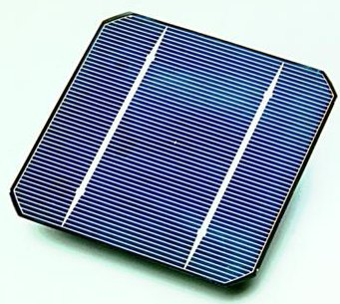
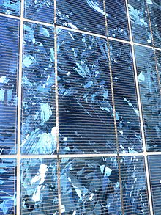
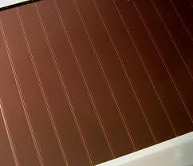
What are solar cells made from?
Most common material = silicon
protection layer
First developed for the space program
P-doped Si
Highest efficiencies of any type of solar cell
junction
Long lifetimes – very stable
B- or Ga-doped Si
Requires thick layers of Si → relatively expensive
Rigid & brittle → limits potential applications
Single crystal - 26%
Polycrystalline - 20%
Amorphous - 13.4%
Notes:
-n-layer is typically phosphorus-doped Si to give an electron-rich material
-p-layer is typically boron- or gallium-doped Si to give an electron-deficient layer

Slide 6
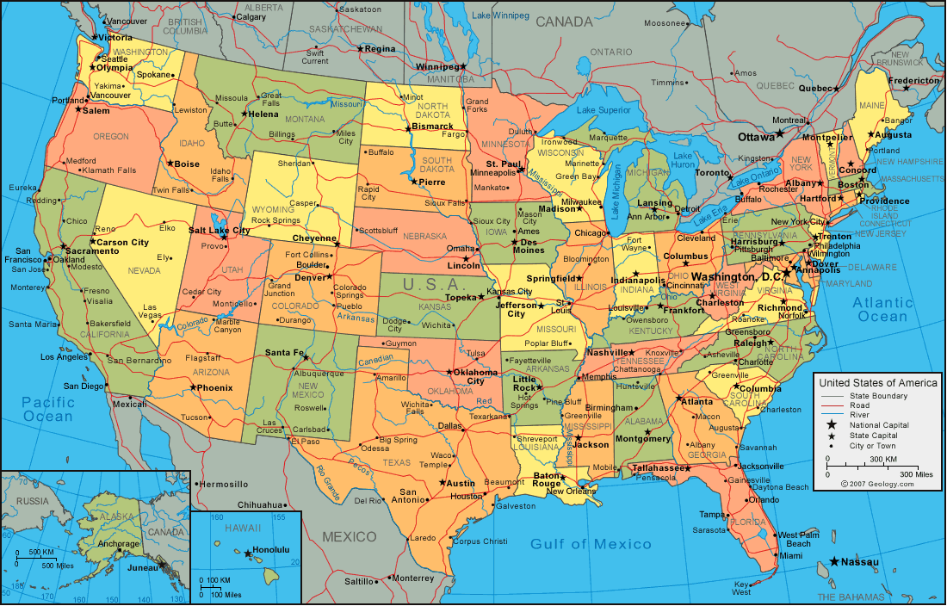
What does this mean for us?
Notes:
(map only) We are hoping to use a lot of solar energy in the future. But will it be enough? How much area on this map would have to be covered with solar cells to generate 1 terawatt of power- that is enough to provide our peak demand. Show with your hands how big an area, a state, the whole country?
(square) this is how much area it would take. We are not saying that we would put all the solar farm in Arizona, Utah, Colorado and New Mexico but it shows there is enough energy hitting the US. But we don’t have to put all the solar panels in one place . They can be put on rooftops, along roadsides, even built into pavement and windows.

Slide 7
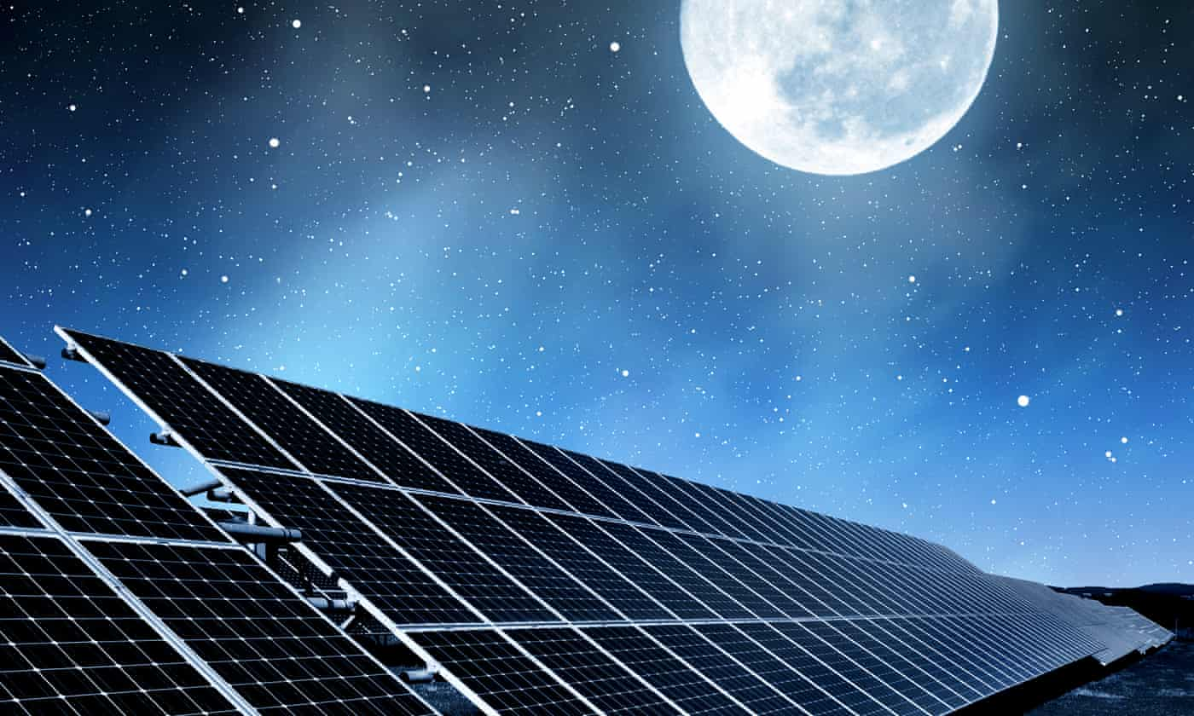
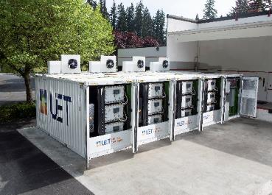
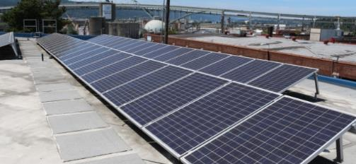
What do you think some challenges with solar energy might be?
They don’t work at night or in cloudy weather
They don’t use all the Sun’s energy
incoming solar radiation
1000 watts/sq meter
Storage
800 W heat
200 W electricity
Notes:
Some possible answers:
-the sun isn’t always shining
-the sun changes position in the sky throughout the day
-how to use all the sun’s light
-making durable solar panels

Slide 8
Key challenge: Improving efficiency
amount of electricity produced
Efficiency =
amount of sunlight received
incoming solar radiation
1000 watts/sq meter
New solar materials ideally need to be:
— Efficient
— Inexpensive
— Abundant materials
— Non-polluting / non-toxic
800 W heat
200 W electricity
Notes:
-One of key challenges to improve solar cells is increasing efficiency
-that includes both increasing the amount of sunlight that can be translating into electricity as well as reducing the amount of energy lost as heat waste

Slide 9
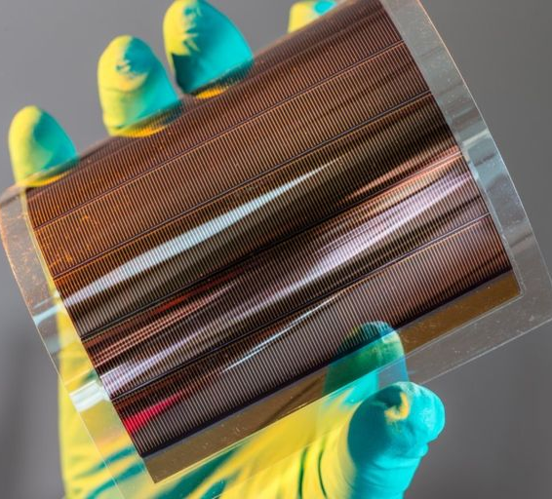
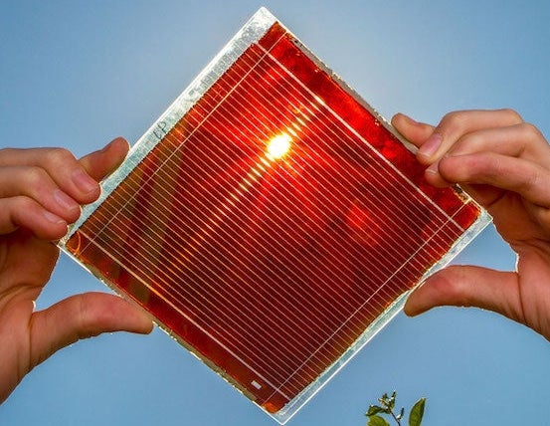

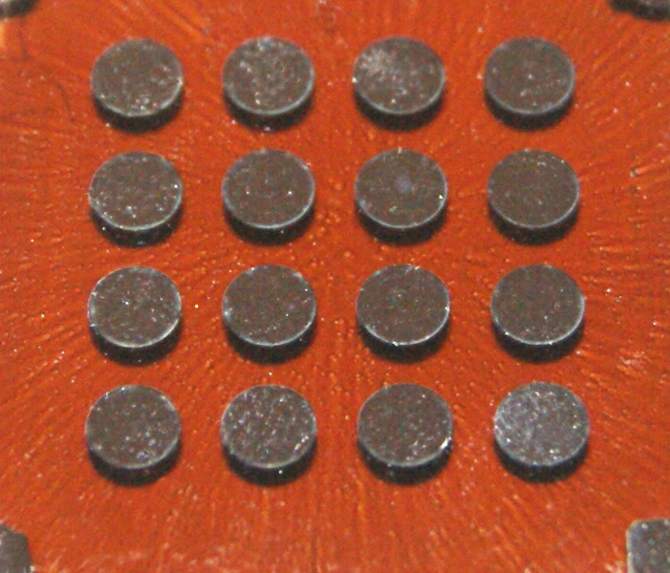
New materials to replace Si
Organic cells
Perovskites
Dye-sensitized cells
Quantum dots
Single crystal Si
11.9%
15.6%
16.6%
23.7%
26.1%
Maximum efficiency

Slide 10
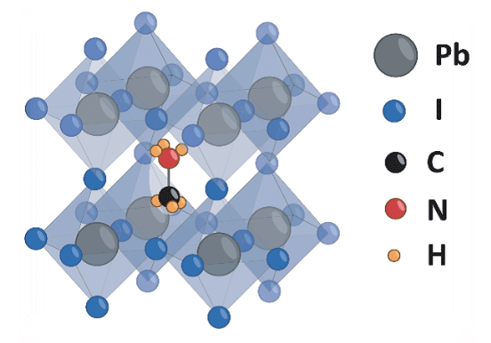
Perovskites
Perovskites are materials with a specific structure called ABX₃
Advantages
— Maximum efficiency = 23.7%
— Variable band gaps
→ can be designed for specific applications
— Very efficient absorber of high-energy light
→ can be combined with other low-energy absorbers
Methyl ammonium lead triiodide perovskite. Image from NREL.
Disadvantages
— Most use lead = extremely toxic
— Poor stability
Image from Solliance.
Notes:
-Perovskite refers to materials with a specific structure
-usually made of lead, a halide (Cl, Br, I), and a positively charged atom or molecule
-poor stability: do not react well to moisture, high heat, or extended irradiation

Slide 11
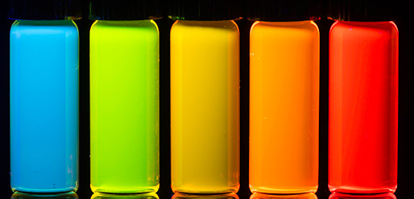
Quantum Dots
4 nm
5 nm
6 nm
QDs are tiny particles only a few nanometers wide
2 nm
3 nm
Image via University of Rochester.
Image via Wikimedia Commons.
Advantages
Disadvantages
— Band gaps change with QD size
→ can be designed for specific applications
— small size means good power to weight ratio
—Most use cadmium or lead
= extremely toxic
— Degrades when exposed to water
and UV light
Notes:
-nanometer = 1 billionth of a meter = 1x10^-9 m = 1x10^-7 cm = 0.0000001 cm
-for solar cells, includes PbS, PbSe, CdS, CdSe
-the various colors of QD could mean solar cells of different colors
-small size means more QDs can fill the same area as an Si solar cell but will produce more power over the same area
-i.e. the same mass of QDs will produce more power than the same mass of Si

Slide 12
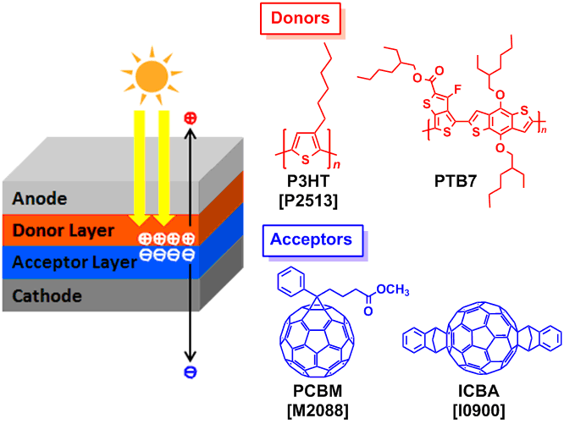
Organic PV Cells
OPVs can be made of any organic (carbon-containing) molecule that absorbs light and can donate/accept electrons
Image via TCI America.
Image via BBC.
Advantages
Disadvantages
— Flexible!
can be deposited on different materials
— Many possible combinations
— Inexpensive to produce
— Low efficiency (at least so far)
— Not very stable
→ no effective protective coatings yet
Notes:
-flexible – could incorporate into clothes
-transparent – windows, glasses!
-the many possible combinations of organic molecules mean OPVs can be designed for different applications
-Solution-processable (meaning organic molecules can be dispersed to form an ink) means it is relatively cheap to produce large quantities of these PVs

Slide 13
Dye-sensitized solar cells
examples of dyes
DSSCs are made of three parts: dye, TiO₂, and liquid electrolyte
Advantages
e⁻
— Easy to make
— Semi-flexible and semi-transparent
— Work in low-light
→ potentially could be used indoors
e⁻
e⁻
e⁻
Disadvantages
e⁻
e⁻
e⁻
— Low efficiencies (so far)
— Requires expensive materials like Pt
— Uses liquids
→ makes it difficult to use in all weather
e⁻
electrolyte
e⁻
e⁻
light
TiO₂
dye
Pt
Notes:
-How a DSSC works:
1) Sunlight is absorbed by the dye molecules
2) The sunlight gives energy to electrons which move from the dye to the TiO2
3)The electrons move between TiO2 molecules and through the circuit, reaching the Pt electrode
4)The electrons are then transferred to the electrolyte which transfers them back to the dye molecules, completing the circuit
-(top left) Examples of dye molecules using Ru metal
-easy to make
-semi-flexible & semi-transparent
-also fairly robust – performs better at higher temperatures
-uses expensive materials like Pt for counter electrode or Ru for dye
-requires liquid component → makes it difficult to use in all weather

