Slide 1
Porous materials with large surface area

Slide 2
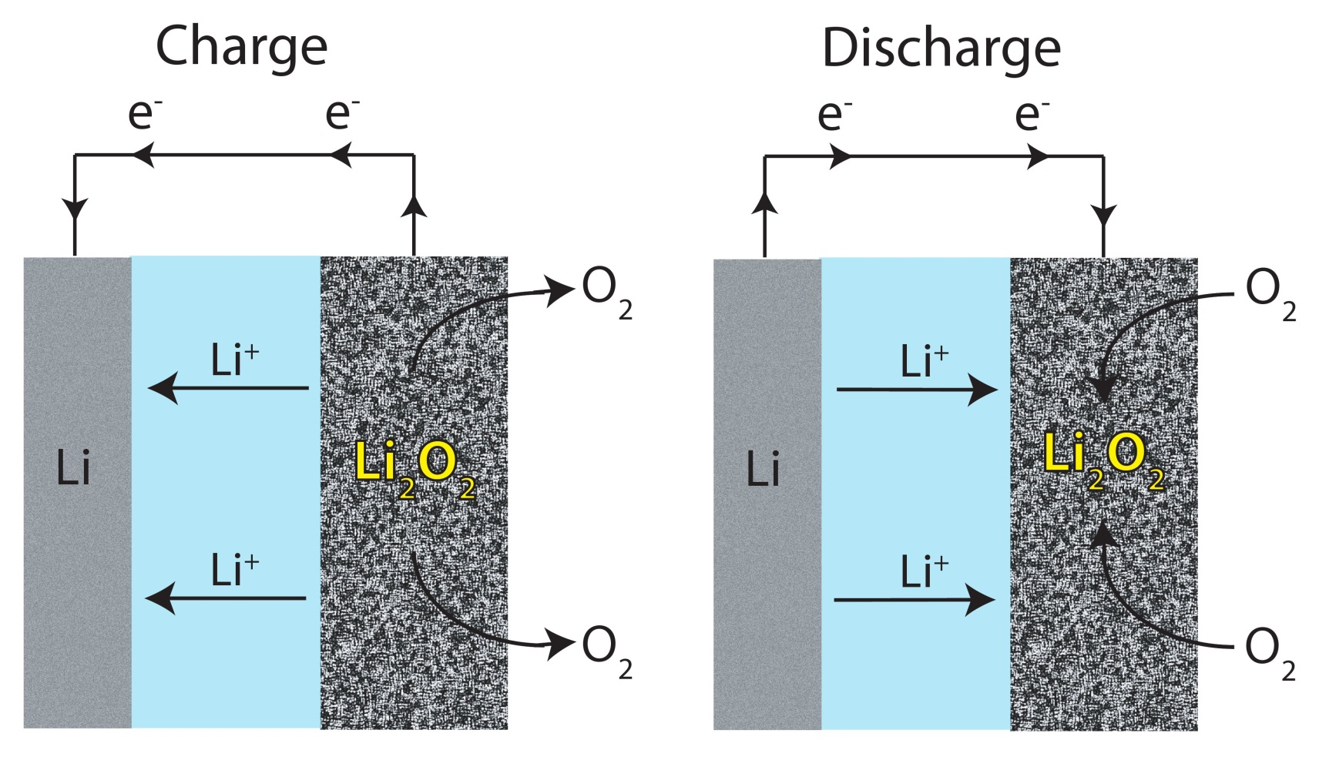
Chemistry in a battery
Notes:
Batteries produce electricity by performing a chemical reaction inside it. The more chemicals you can react at a time, the more power you can produce. These reactions need a surface area where the reaction takes place. The larger this area, the more you can react in a given time.

Slide 3
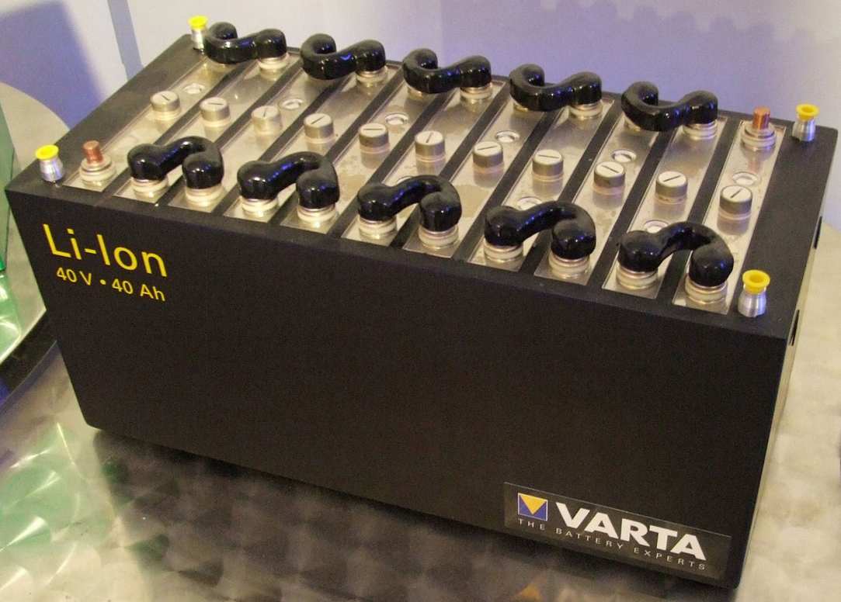
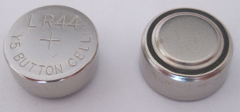
More area = more power
vs.
Notes:
The most obvious way to have greater surface area is to get a bigger battery. But sometimes you want your battery to be small so that it fits in your cellphone or watch.

Slide 4
Challenge: How can we pack a large surface area into a small space?
Notes:
The challenge to scientists is this: how can we pack a large surface area into a small space?

Slide 5
Length = 1
Notes:
Let’s start with a simple example. I have a line segment of length 1.

Slide 6
L = 1
L = 1
L = 1
Total L = 2
Notes:
If I want to have length 2, I can add another segment like this, now the total length is 2.

Slide 7
L = 2
Notes:
But this takes more space and I don’t want that. Can I do something clever to shrink it down but still keep the length 2?

Slide 8
L = 2
Notes:
Let us cut the tip and fold it down like so. Now we have not removed any material, we simply moved it, so the length is still 2.

Slide 9
L = 2
Notes:
It’s better, but I want it even smaller. What can we do now?

Slide 10
L = 2
Notes:
Let’s repeat the procedure, again moving the peaks and keeping the length unchanged at 2.

Slide 11
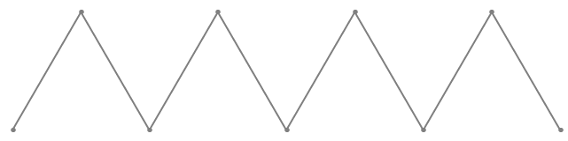
L = 2
Notes:
And repeat.

Slide 12

L = 2
L = 2
L = 2
L = 2
L = 2
L = 2
L = 2
Notes:
We can keep repeating this as many times as we want, until the line becomes essentially straight to our eyes. Now this looks exactly as your original line segment of length 1, however it has length 2!

Slide 13
L = 1
Perimeter = 4
Area = 1
Notes:
Let’s use this same idea for area. Suppose we cut a square window (red) in a material (gray). If the side length is 1, the perimeter is 4 and area 1.

Slide 14
L = 1/2
Total Perimeter = 8
Total Area = 1
Notes:
Now let’s break that window into 4 smaller windows of side length ½. The total area is still 1, but the perimeter is 8.

Slide 15
L = 1/4
Total Perimeter = 16
Total Area = 1
Notes:
We can repeat, and break each of those windows into 4 smaller windows.

Slide 16
See the pattern?
Every time we decrease the length by 1/2, the perimeter increases by a factor of 2.
L=1 Perimeter=4
L=1/2 Perimeter=8
L=1/4 Perimeter=16
Notes:
See the pattern? Every time we cut the side length in half, we double the perimeter. This means that perimeter times side length is a constant. By repeating this process, we can make more and more perimeter, but the total area we cut out is the same – 1.

Slide 17
“Porous materials”
Notes:
By introducing “pores” in a material (becoming like a sponge), it is similar to cutting billions of “windows” just like in our example. The result is an enormous surface area in a very small space. Here are some examples of porous material images taken using a scanning electron microscope. These pores are about 50 nanometers in size, which is 2000 times smaller than the thickness of a sheet of paper!

Slide 18
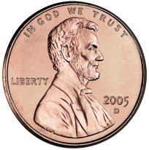
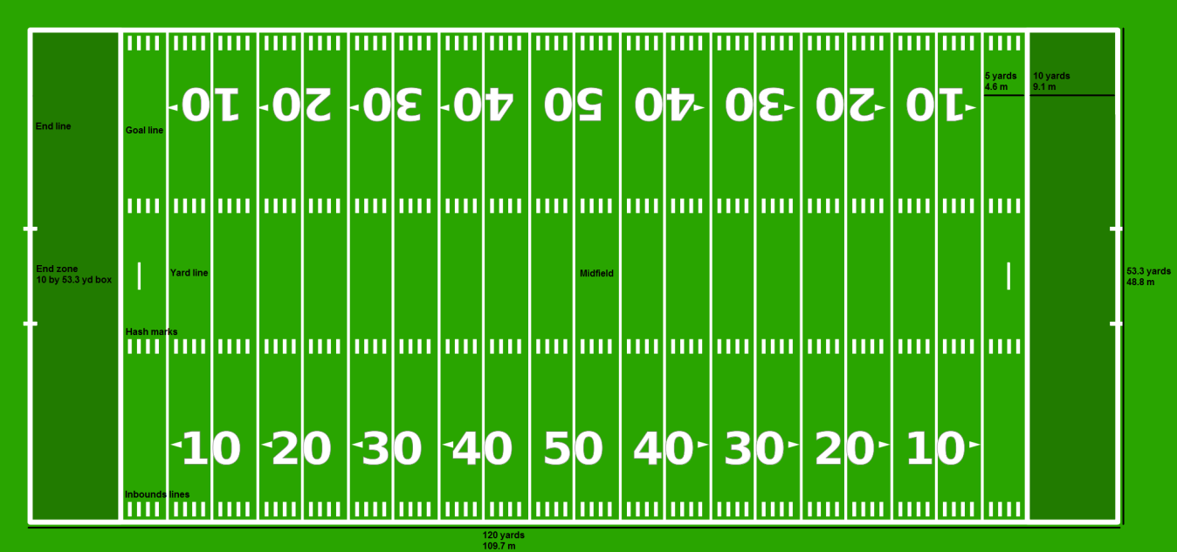
Using this principle, researchers made a microporous carbon with surface area of 3600 m²/g.
This means that a chunk of this material weighing as much as a penny (2.5 g) has the surface area of 1.7 football fields!

Slide 19
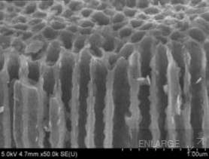
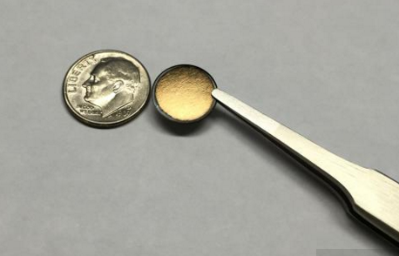
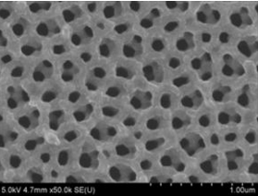
What is it good for?
High efficiency, high power, high storage, small size batteries can be made from porous materials.
Notes:
With this large surface area, the chemicals inside the battery can easily react to produce electricity. High-performance batteries of small size are therefore possible.

Slide 20
References
Zhixin Ma,†, Takashi Kyotani,*,†, Zheng Liu,‡, Osamu Terasaki,§ and, and Akira Tomita†. Very High Surface Area Microporous Carbon with a Three-Dimensional Nano-Array Structure: Synthesis and Its Molecular Structure. Chemistry of Materials 2001 13 (12), 4413-4415 DOI: 10.1021/cm010730l
Aricò, A. S.; Bruce, P.; Scrosati, B.; Tarascon, J. M.; Van Schalkwijk, W. (2005). "Nanostructured materials for advanced energy conversion and storage devices". Nature Materials 4 (5): 366–377.
Bruce Dunn, Jeffrey W. Long, and Debra R. Rolison. "Rethinking Multifunction in Three Dimensions for Miniaturizing Electrical Energy Storage." Electrochemical Society Interface, 2008: 49-53.
Coin Specifications. United States MINT. https://www.usmint.gov/about_the_mint/?action=coin_specifications
2015 NFL Rulebook. National Football League. http://operations.nfl.com/the-rules/2015-nfl-rulebook/#plan-of-playing-field
Wendy Koch, Tiny Batteries Could Revolutionize Green Energy. National Geographic. http://news.nationalgeographic.com/news/energy/2014/11/141117-nanotechnology-for-better-batteries/

