Slide 1
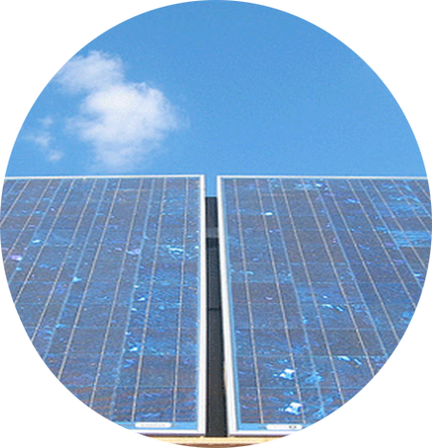
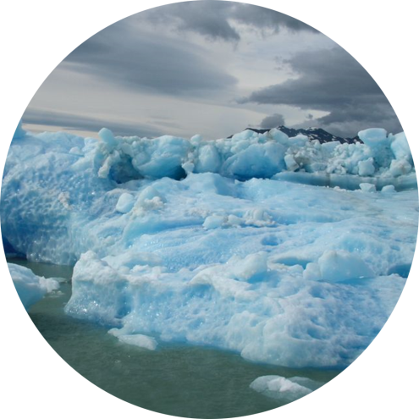
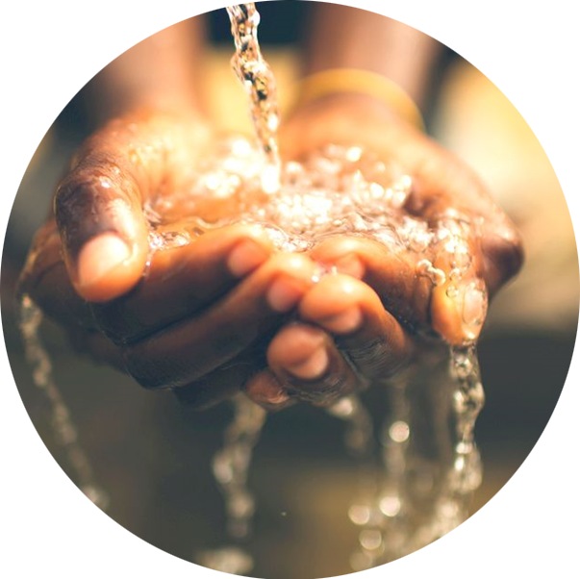
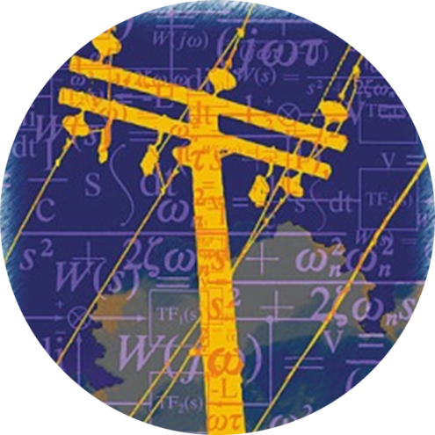
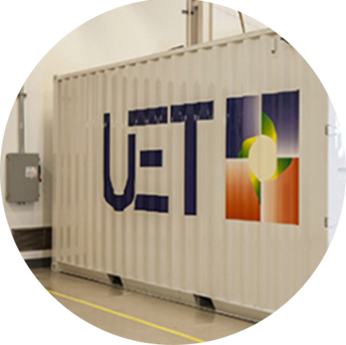

Solar
Grid
Storage
Storage
Accelerating the creation of a scalable, clean energy future

Slide 2
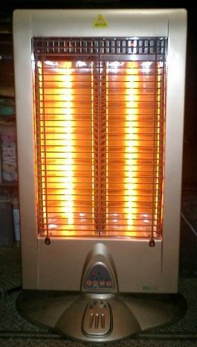
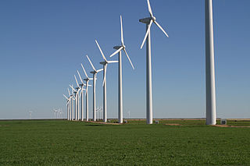
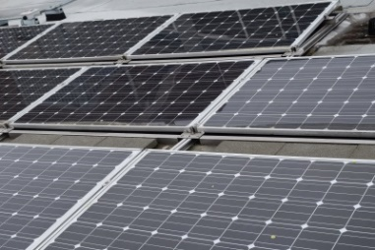
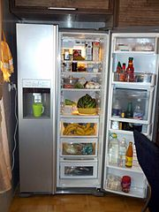
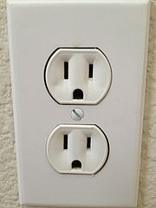
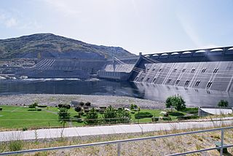
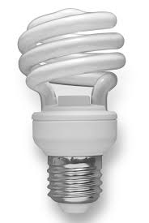
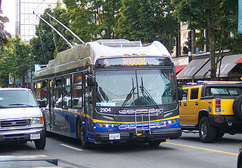
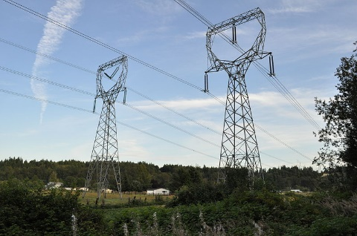
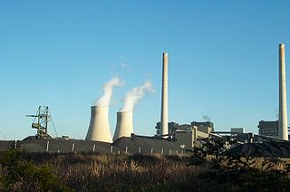
What is energy?
Generation
Distribution
Uses

Slide 3
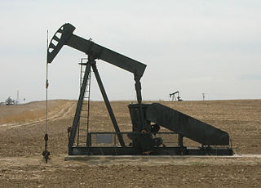
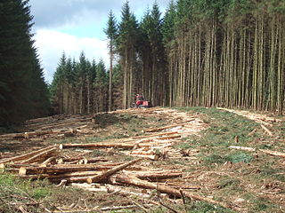
What is clean energy?
Carbon Dioxide
CO₂
Greenhouse Gases
Climate Change
Fossil Fuels
Renewable Energy

Slide 4
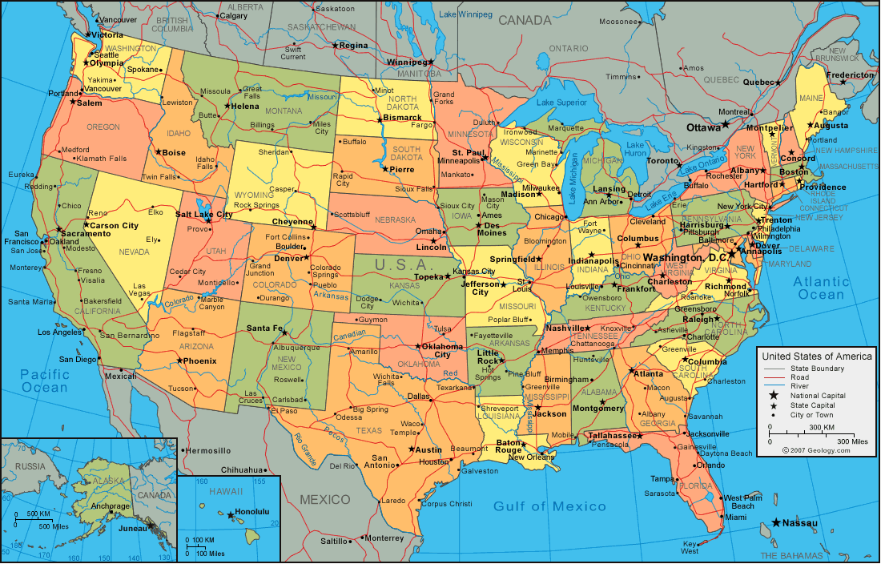
How much area to power US?
~1 TW¹
(total electrical power for US)

Slide 5
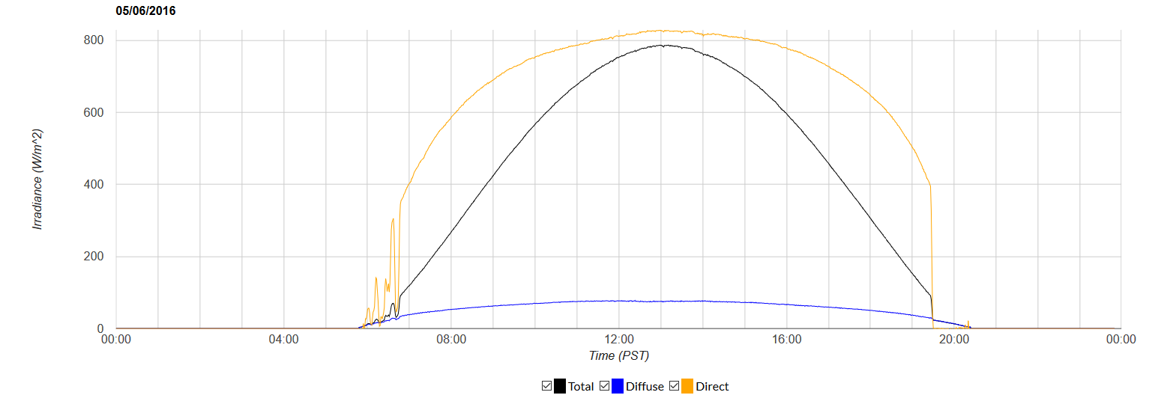
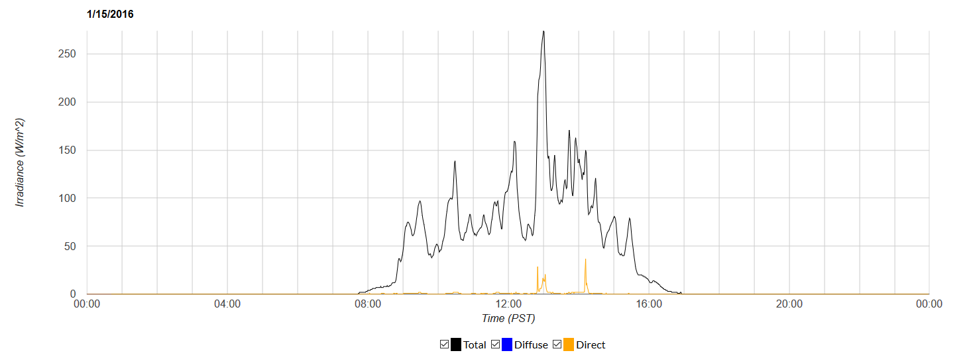
Solar Energy in Seattle
Sunny Day in May
Cloudy Day in January
Full sun irradiance= 1000 watts /square meter

Slide 6
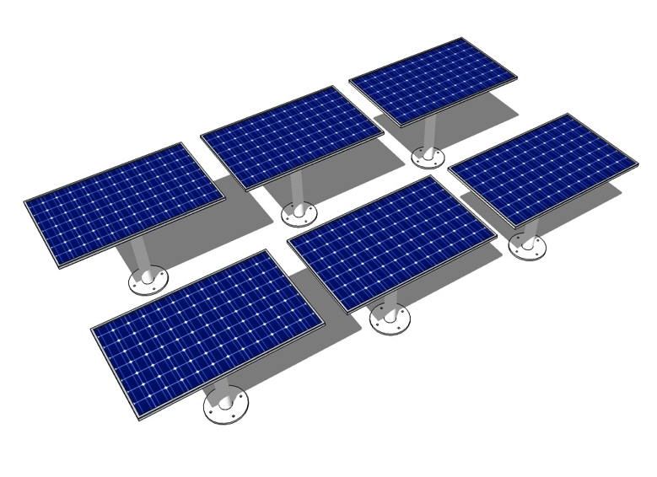

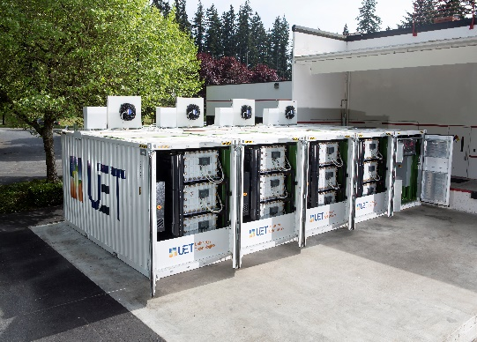
CEI Mission
Accelerate a scalable clean energy future through scientific and technological advances in
+ +
solar storage grid

Slide 7
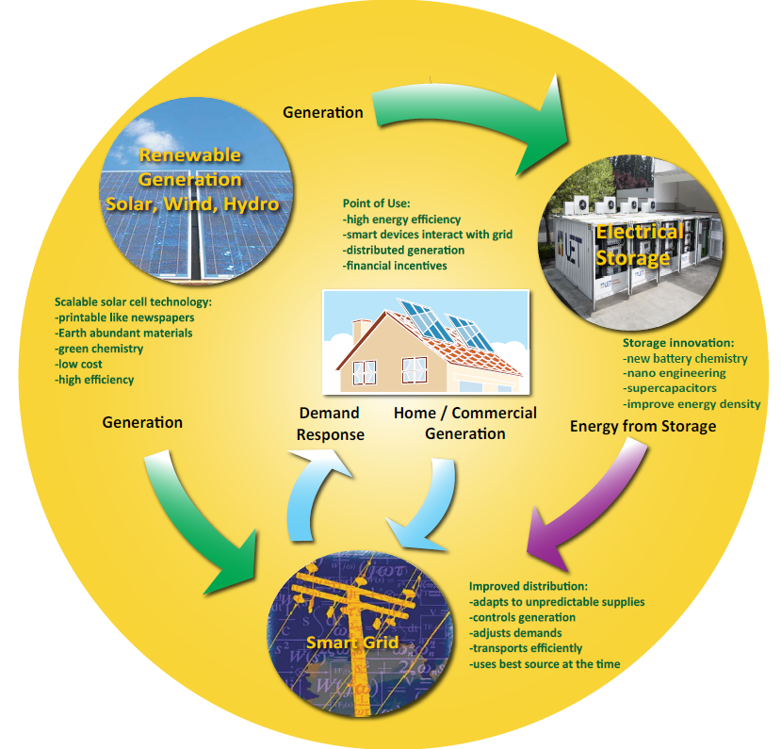
Building a Complete Energy System

Slide 8
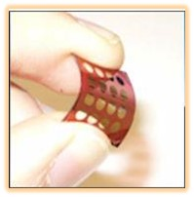

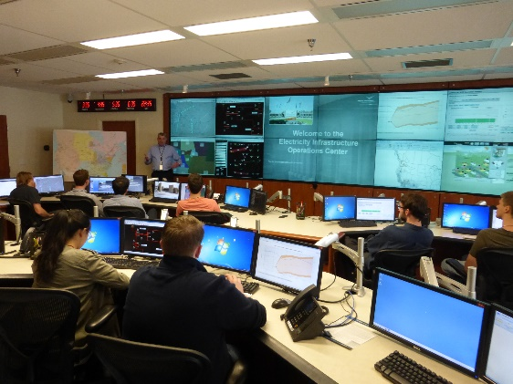
Research Challenges
New solar and battery materials
Efficient
Inexpensive
Plentiful materials
Non-polluting in manufacture and disposal
Home or Grid-scale batteries
Smart devices that can communicate
Smart grid to make
it all work together
Notes:
We have new requirements for energy materials.
New Batteries for devices, cars, and even the entire grid are needed
Smart power consuming devices can talk with the grid and negotiate a best time for use = demand response.
The smart grid must predict unpredictable renewable energy and blend this with traditional generation and demand response.

Slide 9
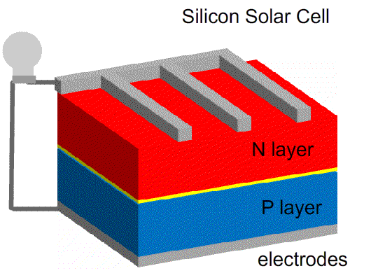
How does a solar cell work?

Slide 10
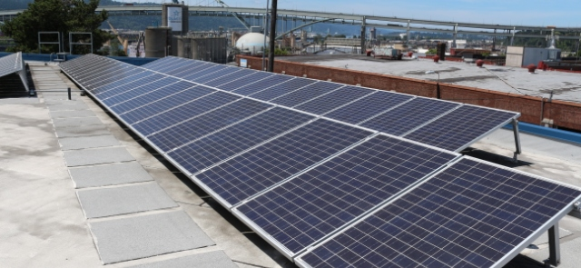
What is efficiency?
Incoming solar radiation
1000 Watt/Sq Meter
Efficiency = Useful output / Total input
2 watt of electricity produced
10 watts solar radiation received
= 20% efficiency
How Efficient are todays solar cells?
5% plastic solar cells
20% Silicon solar cells
45% experimental multijunction cells
200W Electricity
800W Heat
Notes:
Multijunction cells have the highest theoretical efficiency. They consist of different layers of materials with different bandgaps that can absorb each wavelength of light.
Higher efficiency means less area needed and less expense for mounting hardware etc.

Slide 11
Interdisciplinary Research
Chemistry
Physics
Electrical Engineering
Chemical Engineering
Materials Science
Durability
Nanotechnology
Characterization
Controlled
manufacturing
Grids, integration
Devices

Slide 12
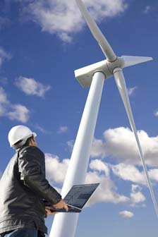
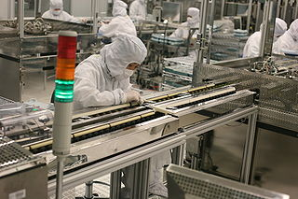
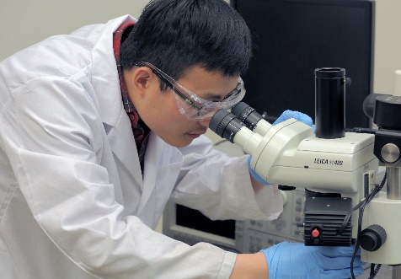
Research Careers
Clean Energy Careers
Years after
School
Opportunities
Technician- solar installer
Sales and system design
Wind turbine mechanic
Industrial research
Business, startups
Teaching at Community Colleges
High tech manufacturing
Faculty- research and teaching at University
Patents
Government Labs
Policy Advisor
Bachelors
Master Degree- 1-2 years
Graduate student is paid to do research in a group led by a faculty (Principle investigator)5-6 yearssome courses, original research, thesis
Post Doc –1-2 year terms at different universities
Ph.D. can become faculty, principle investigator researcher, industry
Associates Degree- Community College
2
4
5-6
8-10
10-15
Notes:
Each level of learning opens more doors and increases your earning potential.

Slide 13
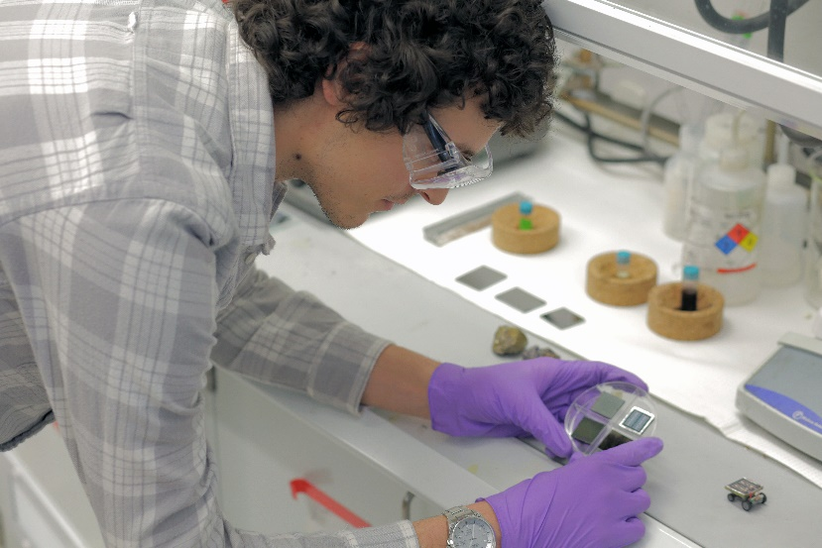
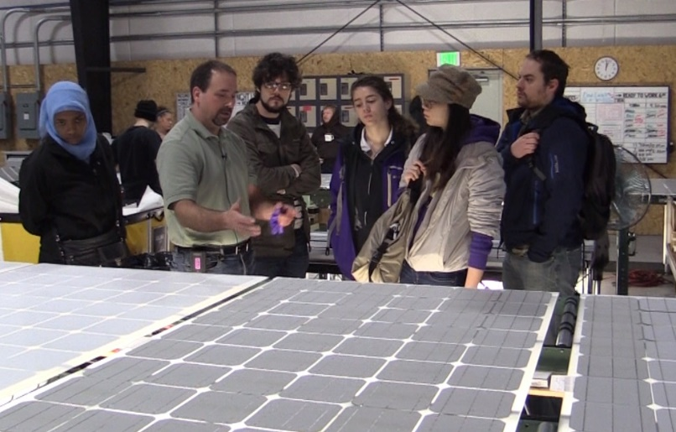

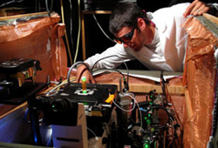
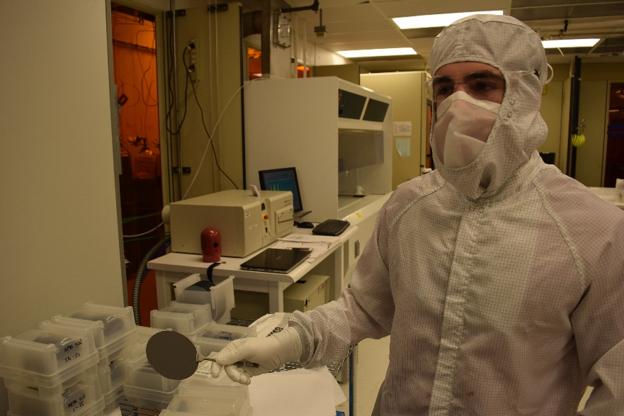
Research Careers

Slide 14
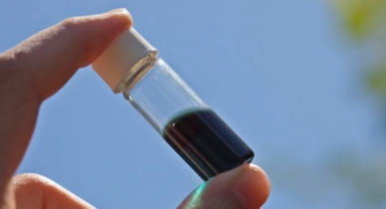
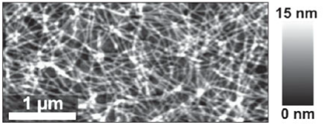
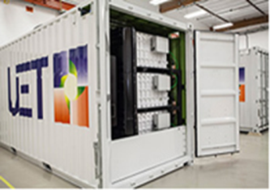
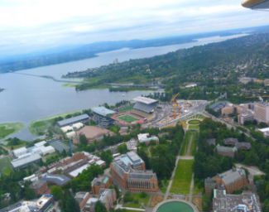

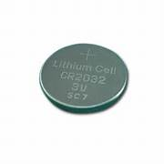
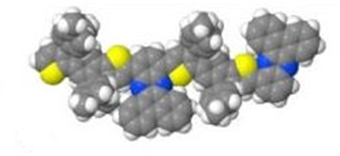
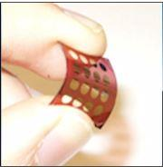
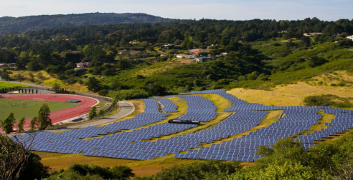
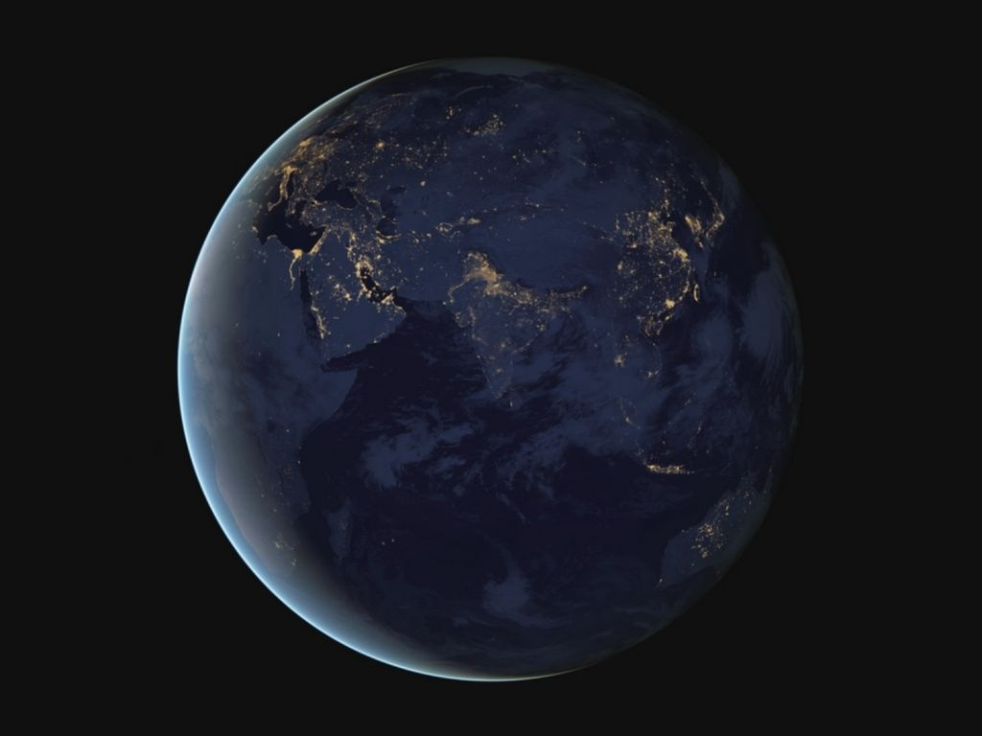
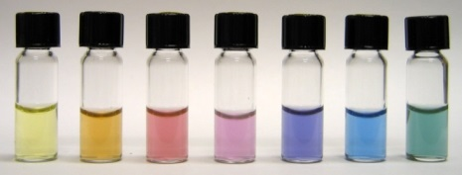
Polymers
10⁻⁹-10⁻⁷ m
Nanostructured
Solar cells
Micro grid
Storage
Regional smart grid
Lithium battery
10⁻¹⁰ m
10⁻⁶
10⁻²
10²
10⁶ m
Molecule
10⁻⁷ m
Solar farm
Global grid
Flexible solar film
Plasmonic materials

Slide 15

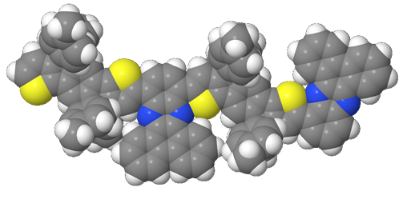
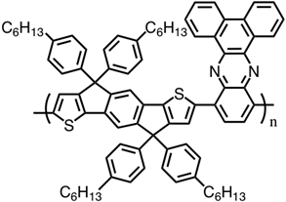
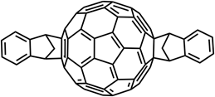
MOLECULAR SCALE
Alex Jen
Christine Luscombe
Notes:
Images still to come

Slide 16
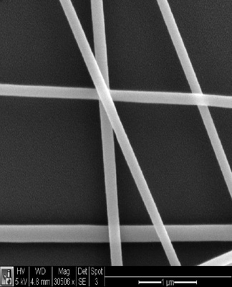
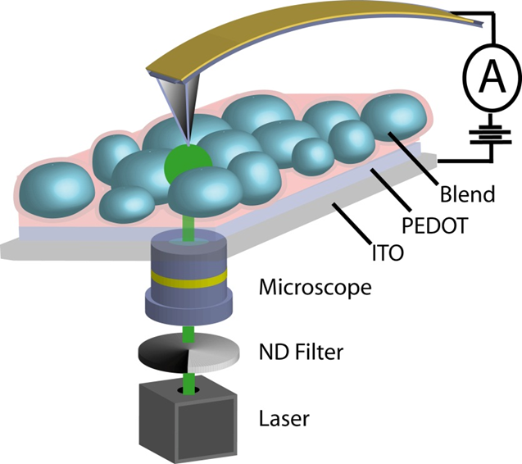
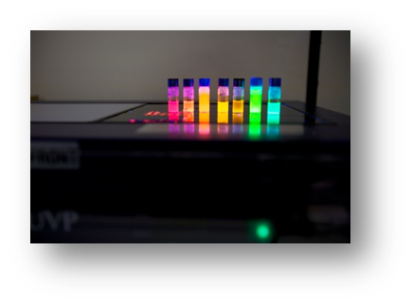

NANOSCALE
David Ginger
David Gamelin
Hugh Hillhouse
Jerry Seidler
Brandi Cossairt
Notes:
Images still to come

Slide 17


MILLIMETERS/CENTIMETERS
Guozhong Cao
Dan Schwartz
Xiaodong Xu
Jihu Yang
Jiangyu Li
Notes:
Images still to come

Slide 18



METERS
Modular solar cell
Printable on roll-to-roll
coater
Applied on windows in the built environment
Notes:
Images still to come

Slide 19




KILOMETERS
Daniel Kirschen
Miguel Ortega Vasquez
Notes:
Arial shot of UW – part of smart grid demo
Not married to the powerline image but I think it illustrates the algorithyms and computer science angle.

Slide 20
Research Process
Observation or
Need
Research
Formulate research question
Choose tools methods
Perform experiments
Analyze results

Slide 21



Clean Energy Ambassadors
Get valuable training and experience in formulating an outreach program (broader impacts)
Produce videos and products of lasting value
Communicating Science to the Public
Visit schools and community events
Solar Car Races, Energy Storage, Solar Cells
High school chemistry an physics labs
Build a solar panel
Measure solar cell peak power
Make a berry solar cell
Electrochemical chameleon

Slide 22





Shared Instrumentation
Lasers, gloveboxes, electrochemistry,
battery making and testing
solar simulators- outdoor test bed
drum coater for scale-up research
Xanes, AFM, TEM, SEM,
Molecular Analysis Facility- MAF
Photonics Research Center
New Testbed Facilities

Slide 23

Efficiency

