Slide 1
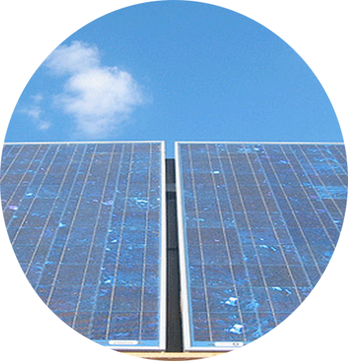
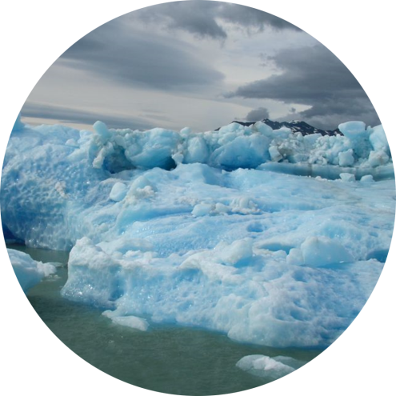

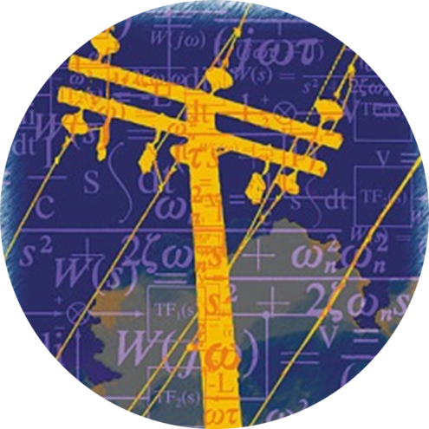
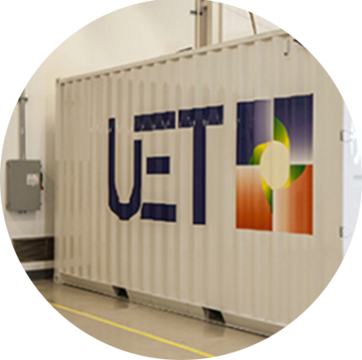

Solar
Grid
Storage
Storage

Slide 2
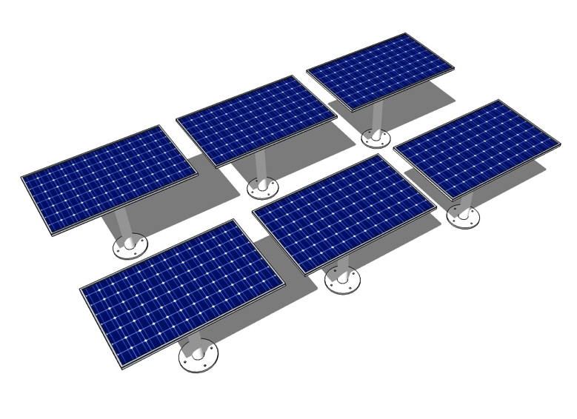

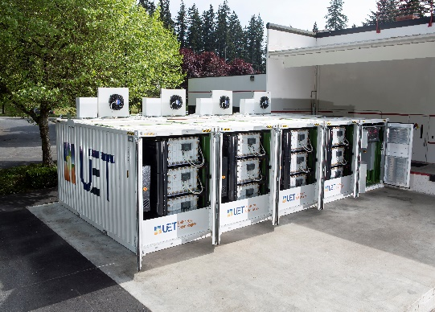
CEI Mission
Accelerate a scalable clean energy future through scientific and technological advances in
+
+
solar
storage
grid
Notes:
The three main thrusts of the clean energy institute are new solar materials, new battery materials and systems, and smart grid to move all the power around.

Slide 3
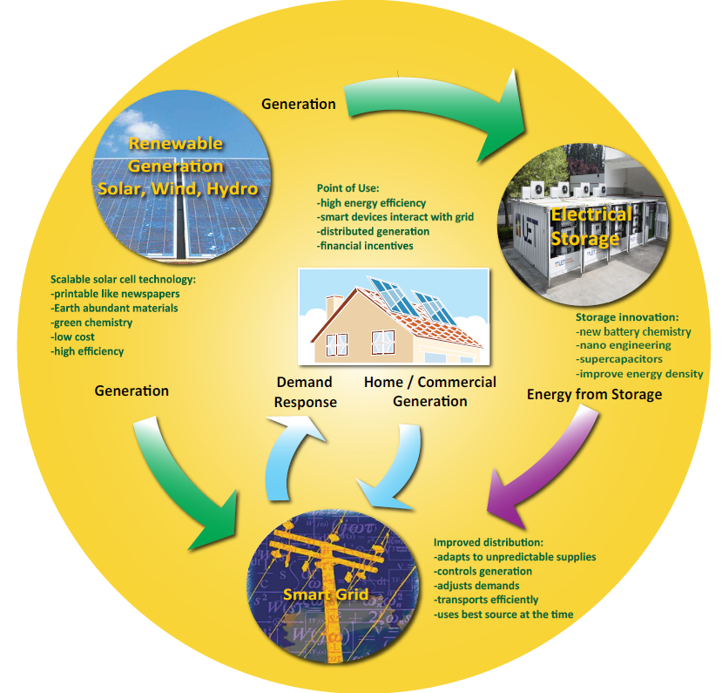
Building a Complete Energy System
Notes:
A complete energy system includes generation, distribution, storage and consumption. Energy from wind or solar farms goes into the grid. It can be used immediately or stored for a few hours until demand peaks. A smart grid is needed to manage the complex flow of energy supply and demand.

Slide 4
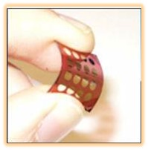

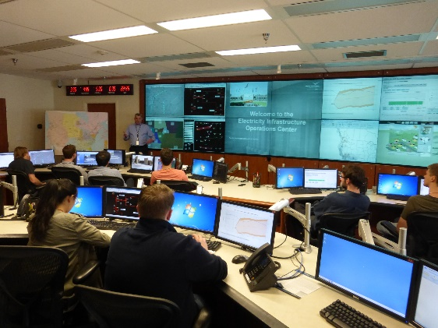
Research Challenges
New solar and battery materials
  Efficient
  Inexpensive
  Plentiful materials
  Non-polluting in manufacture and disposal
Home or Grid-scale batteries
Smart devices that can communicate
Smart grid to make
it all work together
Notes:
We have new requirements for energy materials.
New Batteries for devices, cars, and even the entire grid are needed
Smart power consuming devices can talk with the grid and negotiate a best time for use = demand response.
The smart grid must predict unpredictable renewable energy and blend this with traditional generation and demand response.

Slide 5
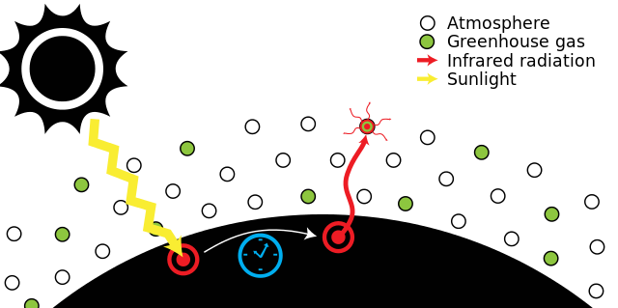
Climate Change
Greenhouse gases : C0₂, CH₄, N₂0
GH gases trap infrared energy -> global warming
Effects: rising seas, storms, droughts, some places become too hot to live
Notes:
There are several greenhouse gases, they differ in their potency at trapping heat, the total amount in the atmosphere, and how long they live after entering the atmosphere. Carbon dioxide is the biggest factor. Methane is more potent, but shorter lived and less plentiful.
Green house gases allow short wavelength visible light to pass through where they are absorbed by the earth and converted to heat which radiates out with long wave infrared that is reflected by the greenhouse gases.
We say climate change because the effects will be varied, some places will be wetter, some much hotter, storms more erratic. Overall the effects are negative and may disrupt society profoundly in places.

Slide 6
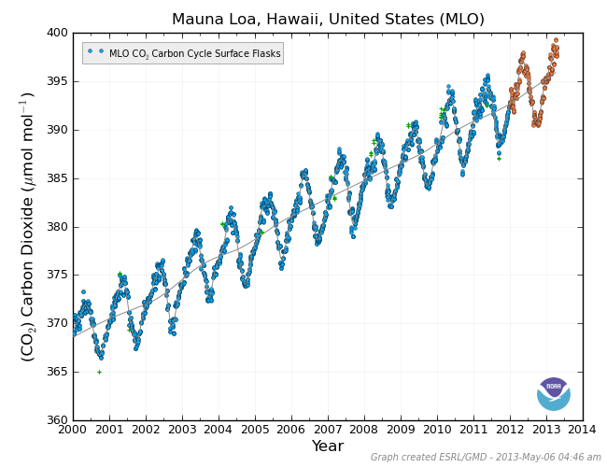
C0₂ now > 400 ppm
Global C0₂ emission rate is greater than plants and oceans can absorb
Spring Maximum
Fall minimum
Average: 2 ppm /year
Notes:
This graph shows the yearly fluctuation of carbon dioxide in parts per million in the atmosphere. The northern hemisphere has much more land plant area than the southern hemisphere. In late spring plants are growing fast and absorb CO2 through photosynthesis into the fall, then as seasonal plants decompose the carbon is released again. The levels fluctuate but each year a net 2ppm is added from human activities such as burning fossil fuels.

Slide 7
Historical Carbon Emissions
Billions of Tons Carbon Emitted per Year
16
8
Historical
emissions
0
1950
2000
2050
2100
Notes:
The CO2 is increasing because humans release about 8 billion tons of carbon per year into the atmosphere. The rate of release is increasing because the population is increasing and much of the world is developing and industrializing. An increasing rate of emission will result in an increasing rate of C02 levels in the atmosphere.

Slide 8
Possible Futures
Do nothing= rising seas, flooded coasts, failed crops, extreme weather disease, famine
Billions of Tons Carbon Emitted per Year
16
Stabilization Triangle
Goal: In 50 years, same
global emissions as today
8
Historical
emissions
Flat path
Long term Goal Net Decrease C02
1.6
0
1950
2000
2050
2100
Notes:
If we do nothing the emissions will continue to increase.. If we stabilized emissions at todays levels we would still have an increase in atmosphere CO2.
Note, some projections call for reduction to below 80% of 2000 levels by 2050 to avoid more than 2C warming
What can we do to remove the carbon represented by the triangle?

Slide 9
Stabilization Wedges
Billions of Tons Carbon Emitted per Year
16 GtC/y
16
Eight “wedges”
Goal: In 50 years, same
global emissions as today
8
Historical
emissions
Flat path
1.6
0
1950
2000
2050
2100
Notes:
Split the problem into a series of wedges which can be addressed with different technologies such as renewable energy, carbon sequestration, conservation, reforestation etc.

Slide 10

What is a wedge?
A “wedge” is a strategy to reduce carbon emissions that grows in 50 years from zero to 1.0 GtC/yr (25 GtC over 25 yrs)
A “solution” to the CO₂ problem should provide at least one wedge.
1 GtC/yr
Total = 25 Gigatons carbon¹
50 years
A wedge from solar requires ~2000-4000 GW_{p} of PV by 2050
or 40-80 GW_{p} per year on a linear ramp¹
Good news: Global PV production is on track to hit 50-55 GW_{p} in 2015
Notes:
To provide one wedge globally solar energy needs to ramp up to 4 terawatts by 2050.
We have the capacity to do this and are on track given current rates of production.
High end of range assumes 100% displacement of coal, low end assumes 100% displacement of gas

Slide 11
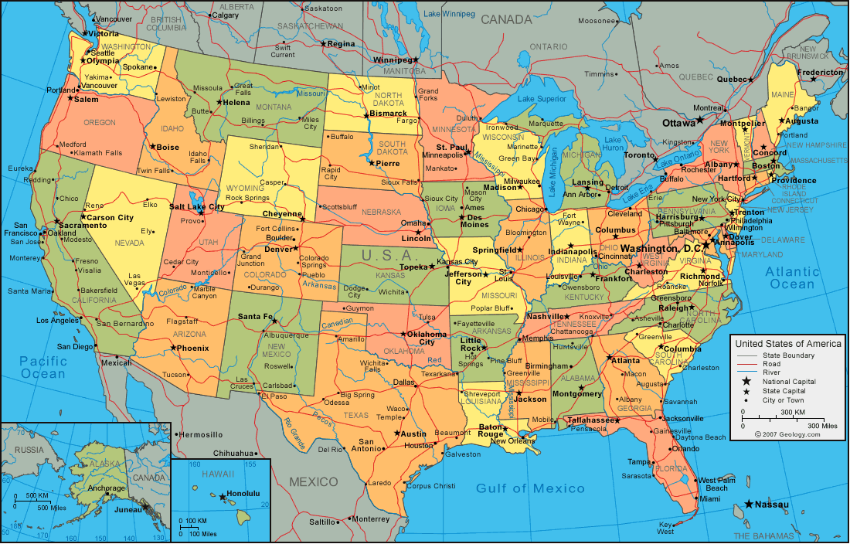
How much area for a terawatt of solar?
efficient, low cost
earth abundant
environmentally benign
long lifetime
printing could be
one way to get here
~1 TW¹
(total electrical power for US)
Notes:
This the area that one terawatt of production represents in the US. Solar farms in the deserts are one possibility, also rooftop of buildings, or distributed along roadways and underutilized land.
1,939 sq. miles
44 miles per side of square
The built environment in the US (buildings, roads, parking lots, etc..) covered an estimated 32000 sq mi in 2009,

Slide 12
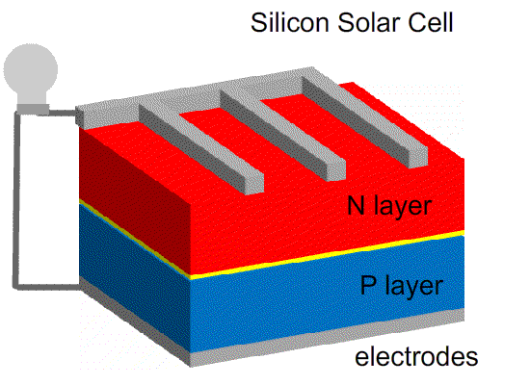
How does a solar cell work?
Notes:
The solar cell has two layers, one electron rich one electron poor. When a photon from light hits the interface it kicks a electron free which travels to the collection grid, through the circuit and to the back contact. The metal grid is needed to reduce the resistance to electrical flow.

Slide 13
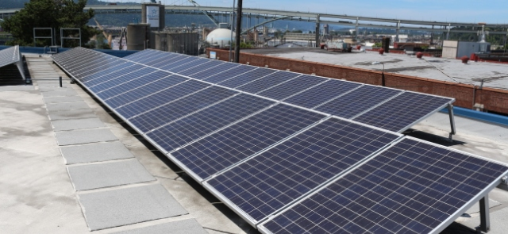
What is efficiency?
Incoming solar radiation
1000 Watt/Sq Meter
Efficiency = Useful output / Total input
2 watt of electricity produced
10 watts solar radiation received
= 20% efficiency
How Efficient are todays solar cells?
  5% plastic solar cells
  20% Silicon solar cells
  45% experimental multijunction cells
200W Electricity
800W Heat
Notes:
Multijunction cells have the highest theoretical efficiency. They consist of different layers of materials with different bandgaps that can absorb each wavelength of light.
Higher efficiency means less area needed and less expense for mounting hardware etc.

Slide 14
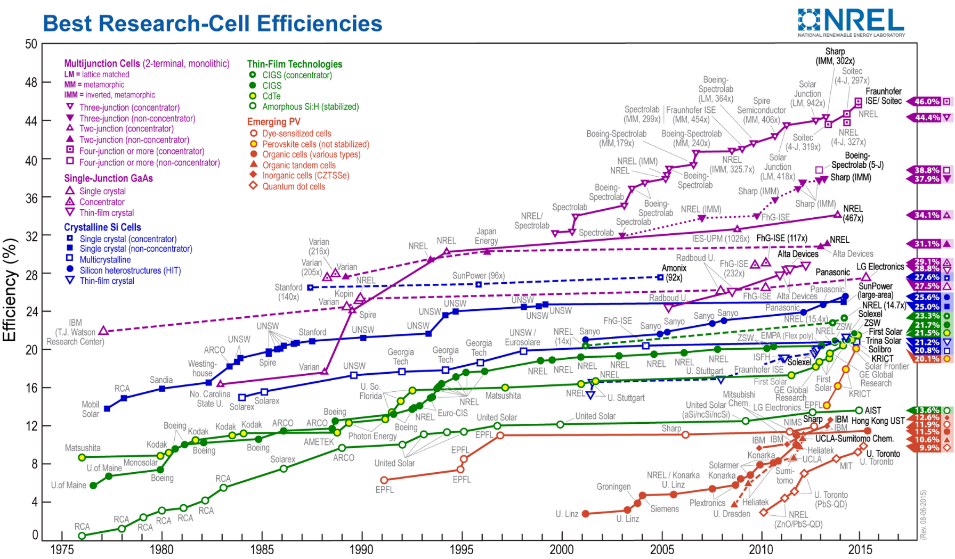
Research Improves Efficiency
Notes:
This graph shows the trend of increasing efficiency in solar technologies due to research and development.
The blue line in the middle shows that silicon solar has pretty much leveled off at about 20%.
The purple line at the top is new experimental cells that are very expensive, mostly useful or space applications.
The red lines on the lower right are new thin film technologies such as perovskites which will be cheap to produce and whose efficiency is increasing rapidly.

Slide 15
Science Research Process
Observation or
Need
Analyze
results
Research
Learn and Modify
Perform experiments
Formulate question / hypothesis
Choose tools methods
Notes:
In scientific research we follow a cycle of repeating experiments, each time modifying our methods or hypothesis based on what we have learned.

Slide 16
Engineering Process
Define the Problem
Analyze
results
Research
Learn and Modify
Test
Prototype
Specify Requirements
Brainstorm / Choose a solution
Notes:
Engineering focuses on solving a particular problem but it uses many of the same skills as a scientist. Instead of doing an experiment you test a prototype and use the information gained to modify the design.

Slide 17
Interdisciplinary Research
Chemistry
Physics
Electrical Engineering
Chemical Engineering
Materials Science
Durability
Nanotechnology
Characterization
Controlled
manufacturing
Grids, integration
Devices
Notes:
In this research field the divisions between engineering and pure science are blurred. Each discipline brings its own understandings and capabilities to the problem. Often interdisciplinary teams are required.

Slide 18
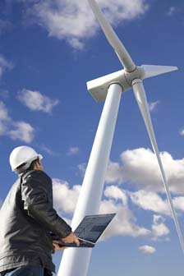
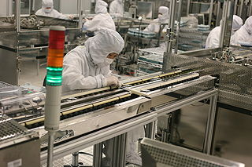
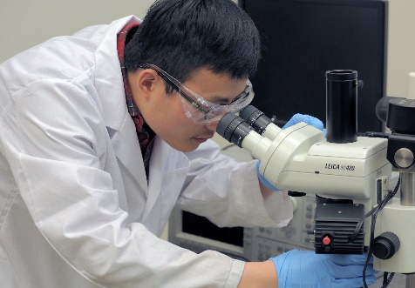
Research Careers
Clean Energy Careers
Years after
School
Opportunities
Technician- solar installer
Sales and system design
Wind turbine mechanic
Industrial research
Business, startups
Teaching at Community Colleges
High tech manufacturing
Faculty- research and teaching at University
Patents
Government Labs
Policy Advisor
Bachelors
Master Degree- 1-2 years
Graduate student is paid to do research in a group led by a faculty (Principle investigator)5-6 yearssome courses, original research, thesis
Post Doc –1-2 year terms at different universities
Ph.D. can become faculty, principle investigator researcher, industry
Associates Degree- Community College
2
4
5-6
8-10
10-15
Notes:
Each level of learning opens more doors and increases your earning potential.

Slide 19
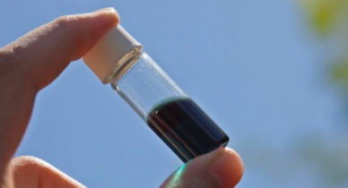
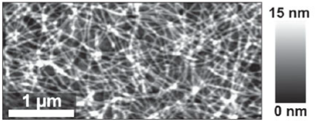
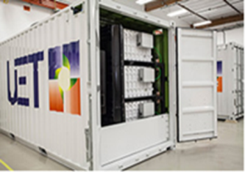
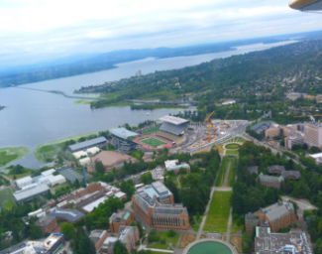

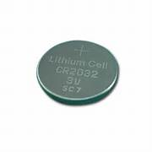
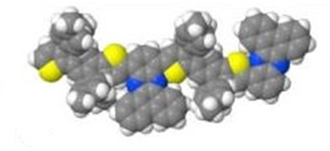
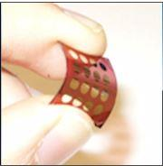
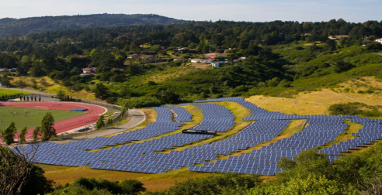
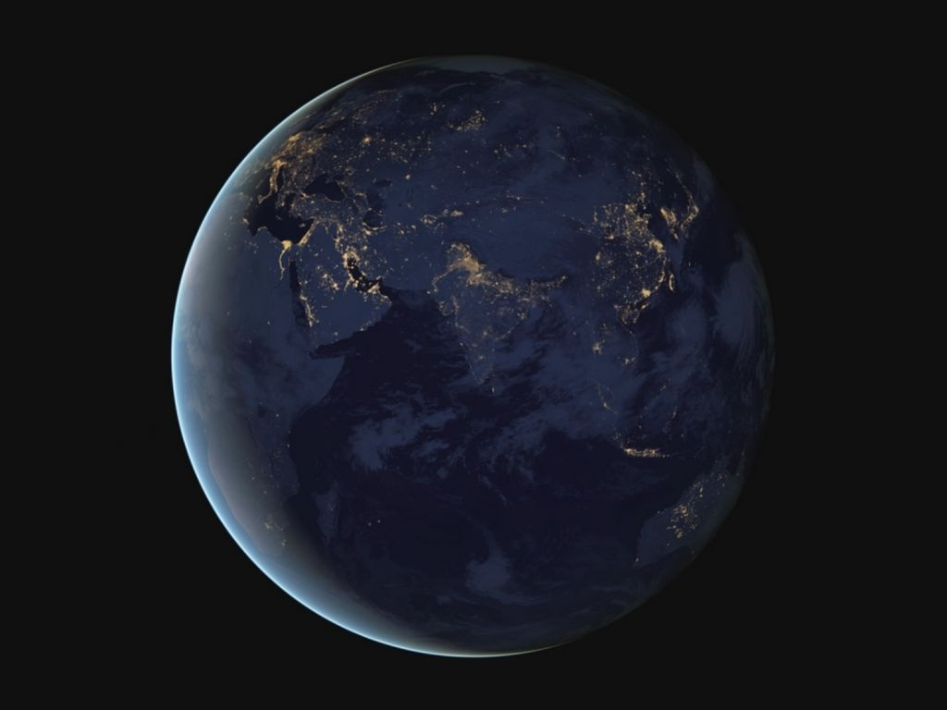
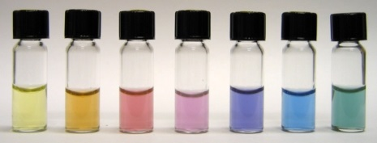
Polymers
10⁻⁹-10⁻⁷ m
Nanostructured
Solar cells
Micro grid
Storage
Regional smart grid
Lithium battery
10⁻¹⁰ m
10⁻⁶
10⁻²
10²
10⁶ m
Molecule
10⁻⁷ m
Solar farm
Global grid
Flexible solar film
Plasmonic materials
Notes:
Research involves many levels of scale.

Slide 20

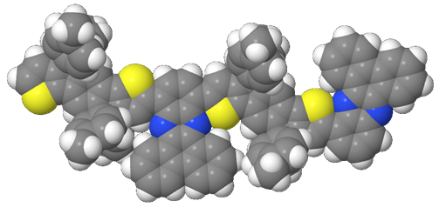
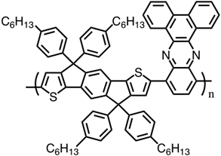
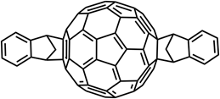
MOLECULAR SCALE
Alex Jen
Christine Luscombe
Notes:
Molecules are designed to perform a specific function like trapping light or conducting electricity.

Slide 21
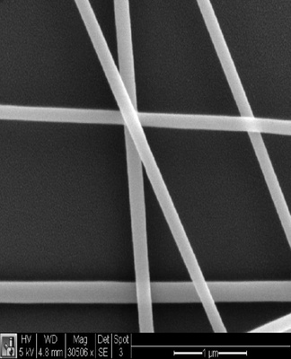
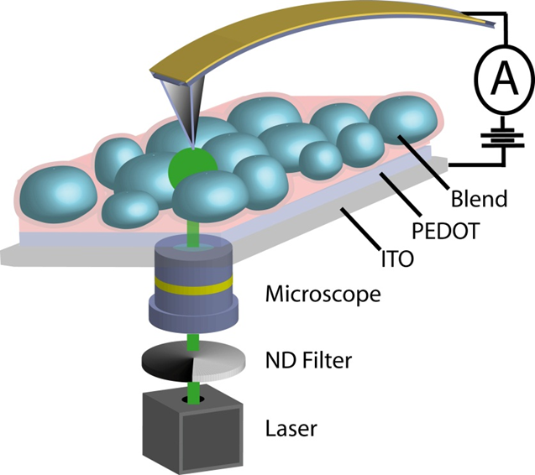
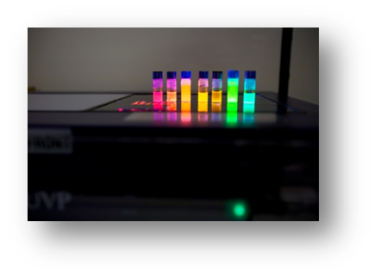
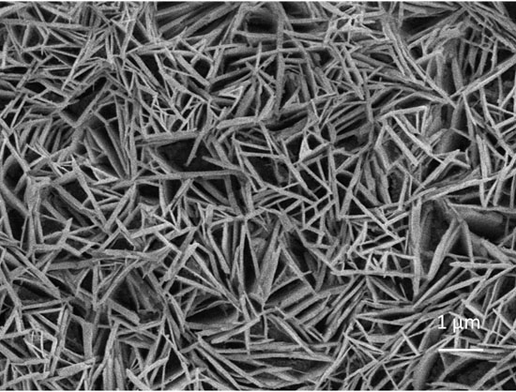
NANOSCALE
David Ginger
David Gamelin
Hugh Hillhouse
Jerry Seidler
Brandi Cossairt
Notes:
Materials can modified at the nanoscale creating new properties. Also tools like the atom force microscope allow us to see structures at this scale.

Slide 22
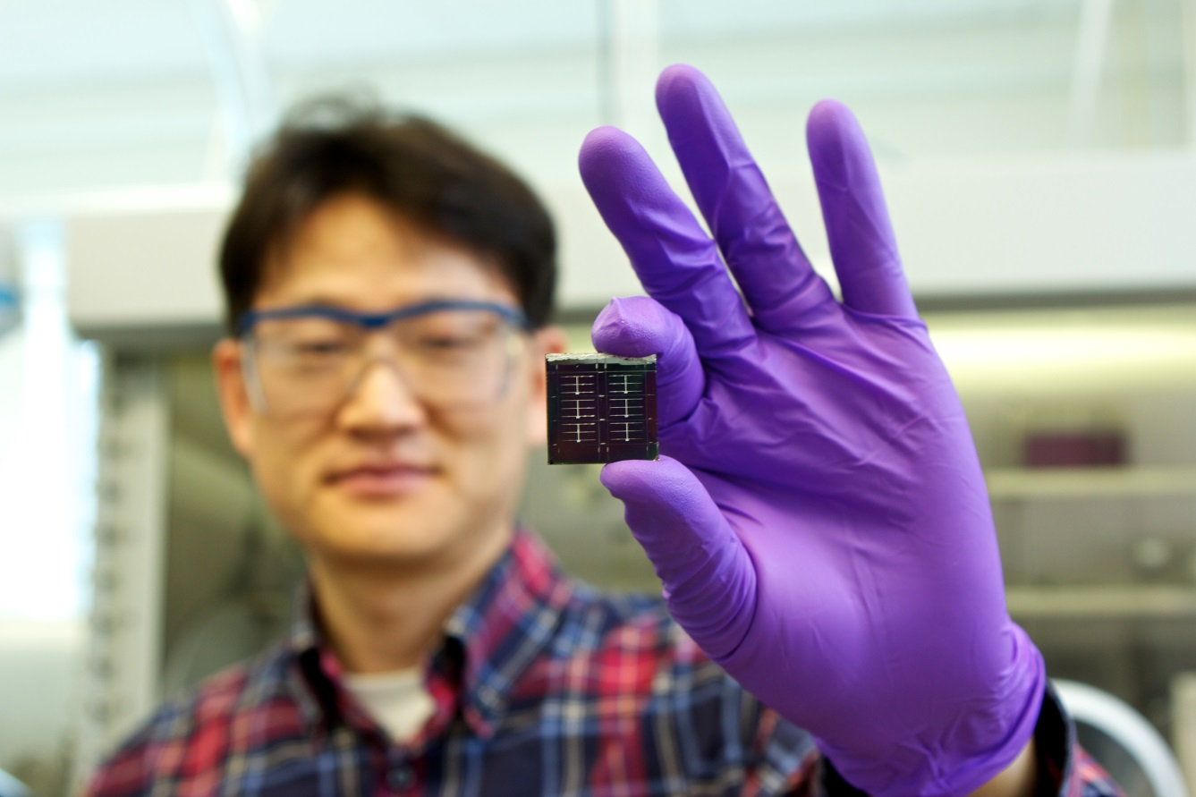
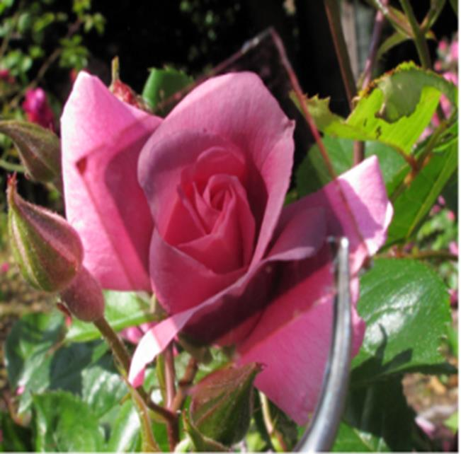
MILLIMETERS/CENTIMETERS
Guozhong Cao
Dan Schwartz
Xiaodong Xu
Jihu Yang
Jiangyu Li
Notes:
Small devices like a coin cell battery or solar cell are often made to test the performance of the system with a minimum of materials. Once a system and manufacturing method are perfected devices can be scaled up for large scale manufacturing.

Slide 23
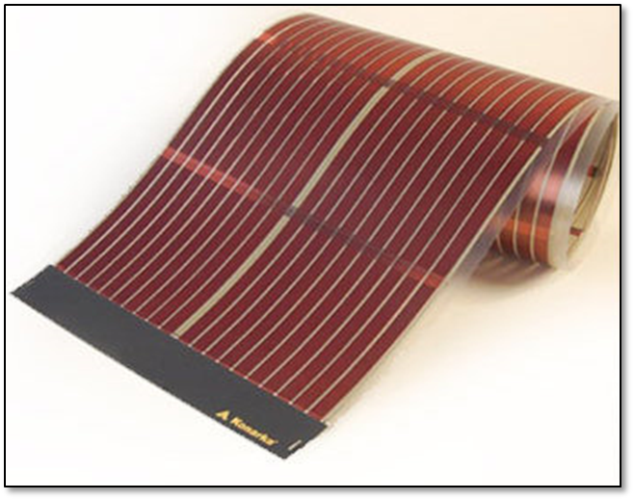
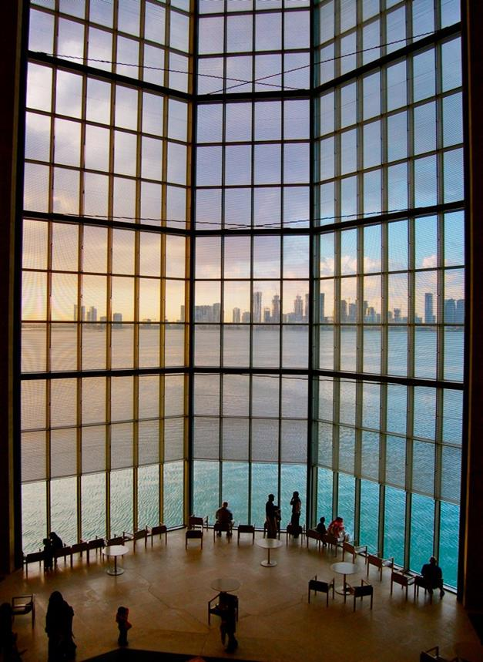
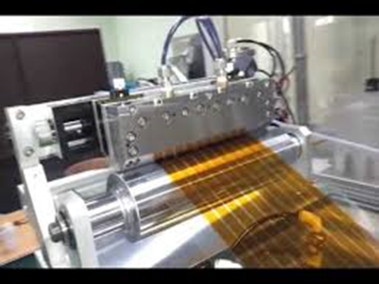
METERS
Modular solar cell
Printable on roll-to-roll
coater
Applied on windows in the built environment
Notes:
New solar materials will have to cover hundreds of square meters of area to make a difference in the energy situation. This requires inexpensive manufacturing systems like the roll to roll printers.

Slide 24


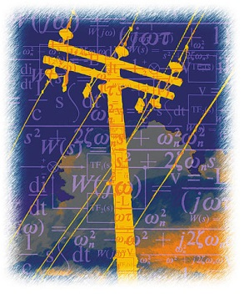
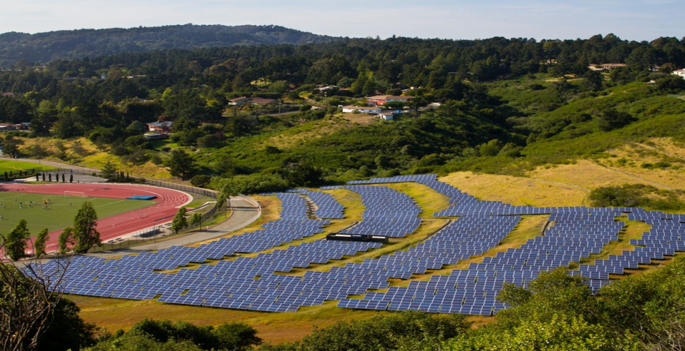
KILOMETERS
Daniel Kirschen
Miguel Ortega Vasquez
Notes:
The national grid has to be modified to accommodate renewable energy and new technologies.

Slide 25
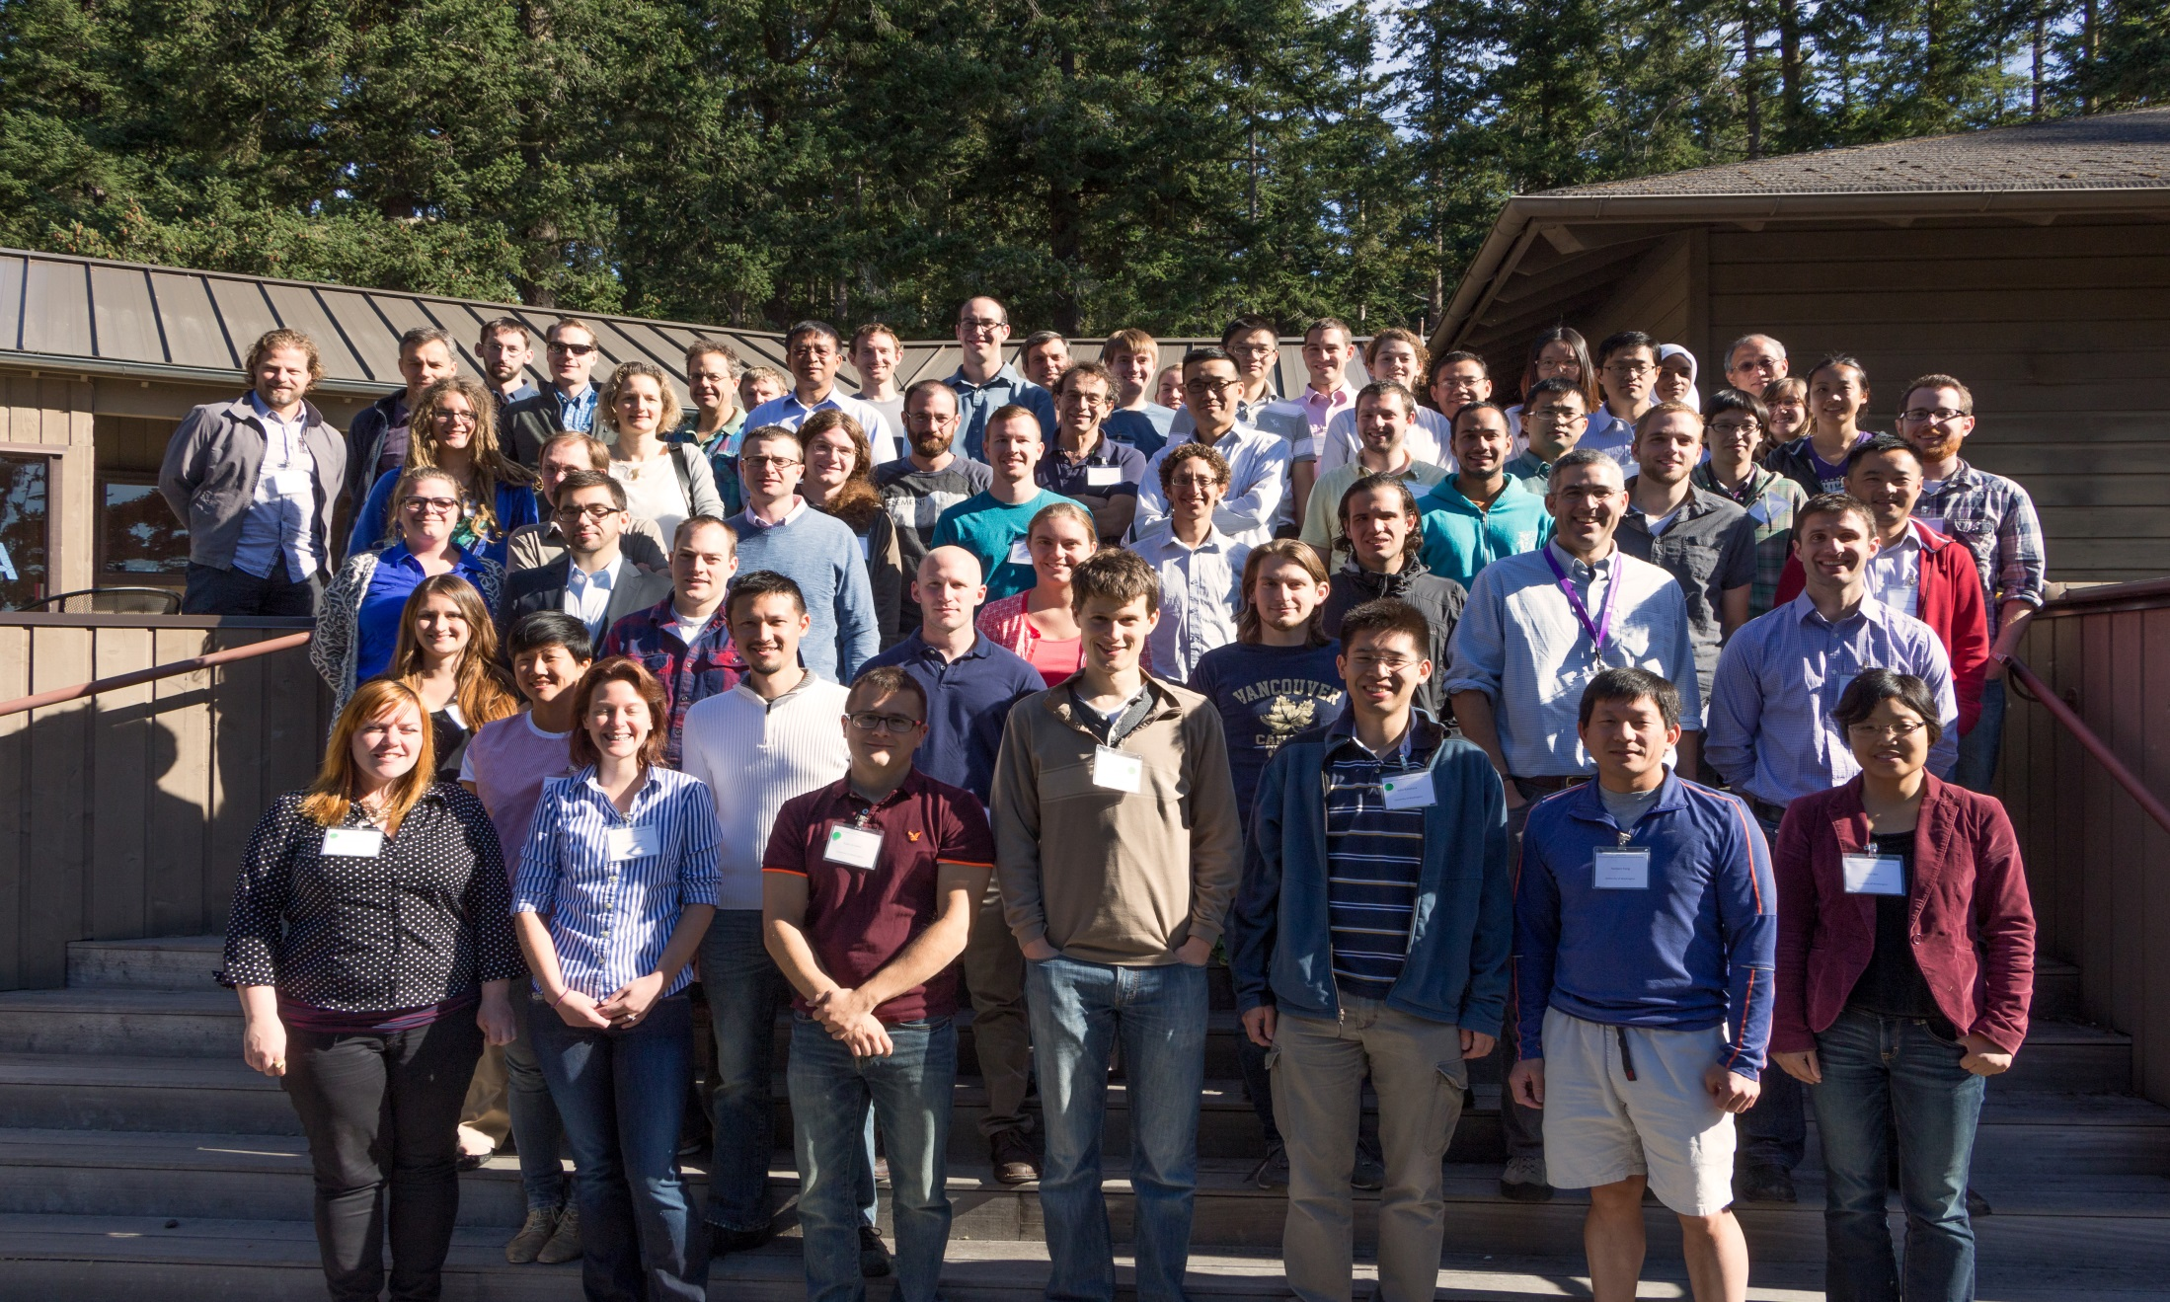
Thank you!

Slide 26

CEI Origins
Established in 2013 with proviso funding from
Washington State Legislature.
Now an permanent UW institute.
24 faculty members from Materials Science, Chemistry, Physics, Electrical Engineering
67 Clean Energy Fellows (2014, 2015, 2016)
13 Recruiting Fellows
6 Washington Research Foundation Innovation Postdocs
7 ongoing Student Training and Exploration grants
Continually expanding faculty depth in Clean Energy

Slide 27
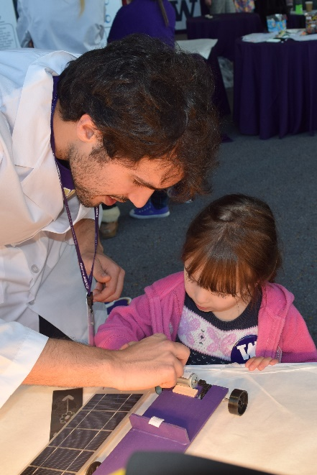
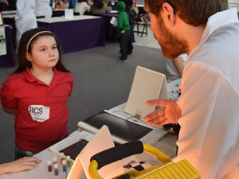
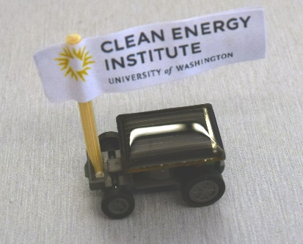
Clean Energy Ambassadors
Get valuable training and experience in formulating an outreach program (broader impacts)
Produce videos and products of lasting value
Communicating Science to the Public
Visit schools and community events
Solar Car Races, Energy Storage, Solar Cells
High school chemistry an physics labs
  Build a solar panel
  Measure solar cell peak power
  Make a berry solar cell
  Electrochemical chameleon

