Slide 1


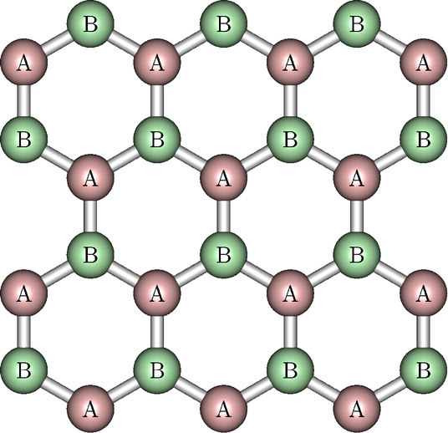
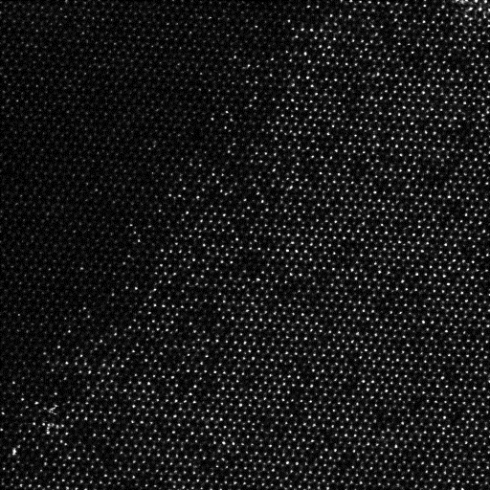
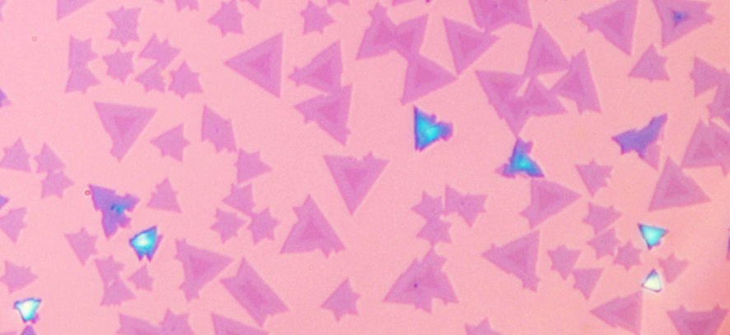
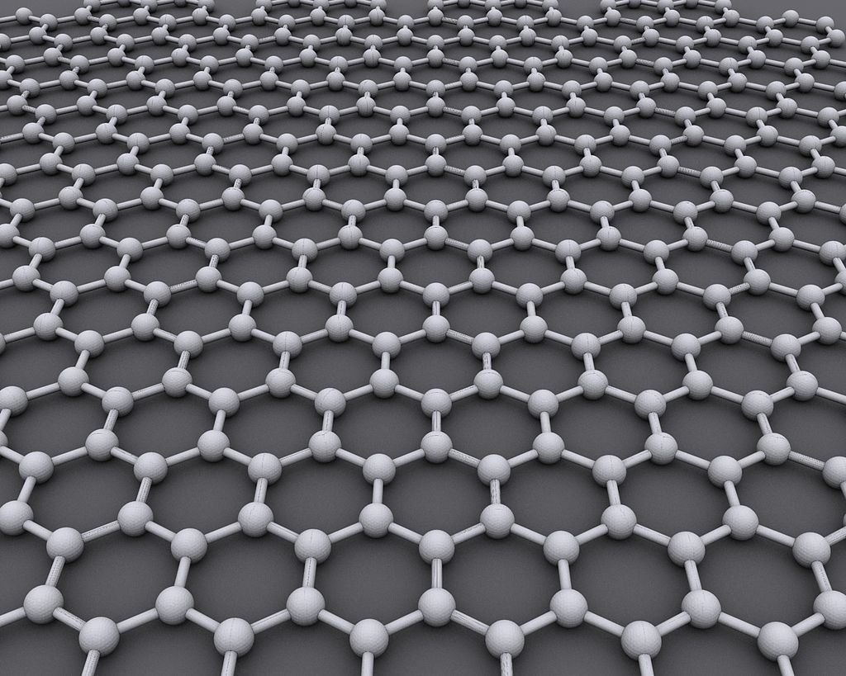
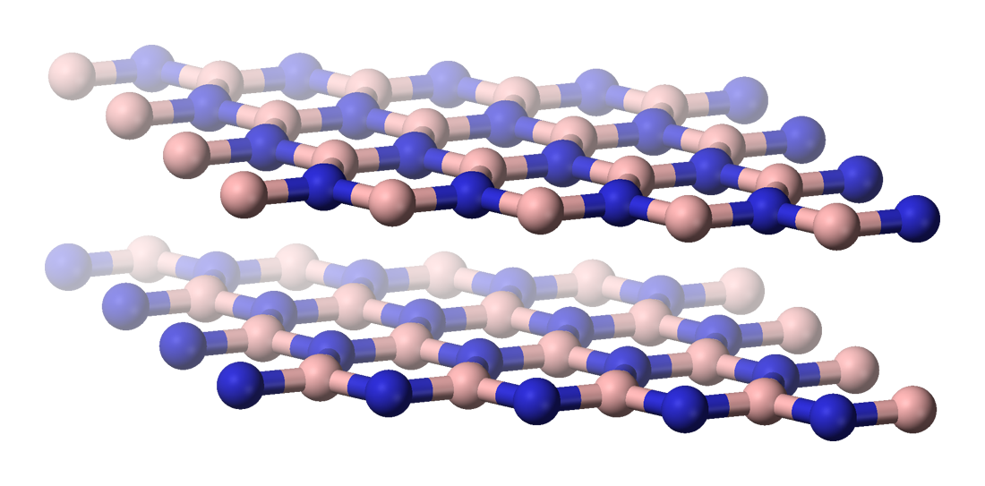
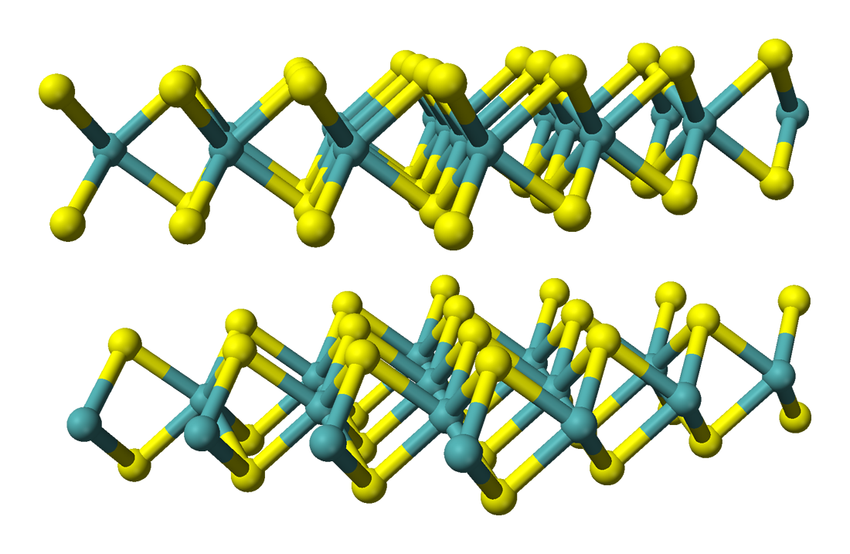
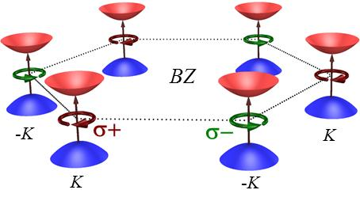
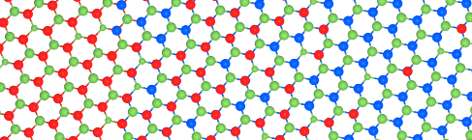
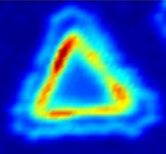
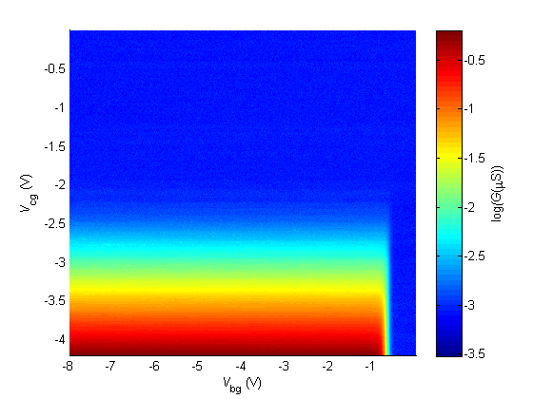
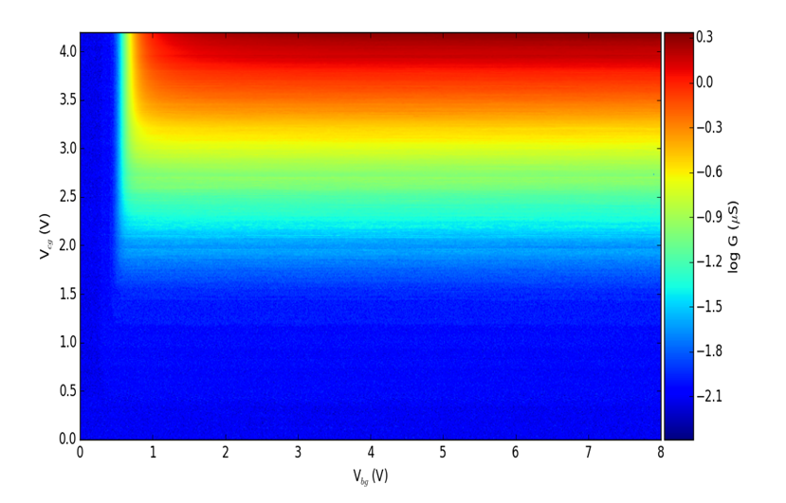
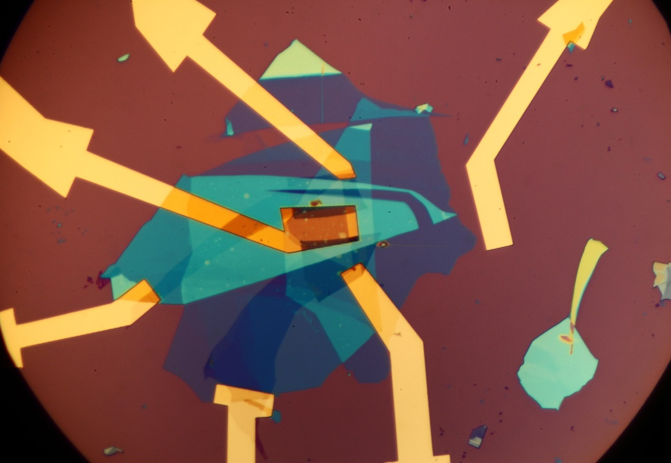
Electrical contacts to two dimensional semiconductors
Wenjin Zhao, Tauno Palomaki, Joe Finney, Zaiyao Fei, Paul Nguyen, Frank McKay, David H. Cobden
Nanodevice Physics Lab, Department of Physics, University of Washington, Seattle WA 98195-1560
2D materials: graphene, h-BN and WSe₂
WSe₂ and MoSe₂ hererojunction
WSe₂ monolayer
Triangular monolayer crystals containing lateral heterojunctions between monolayer MoSe₂ and WSe₂ grown by physical vapor transport on SiO₂
The development of atomically thin layers of van der Waals bonded solids has opened up new possibilities for the exploration of 2D physics as well as for materials for applications. There are semimetals, insulators and semiconductors among them. Combining them into heterostructures offers a new route to efficient, stable and flexible solar cells. Below are the structures of graphene, hexagonal boron nitride (h-BN) and tungsten diselenide (WSe₂).
WSe₂
MoSe₂
WSe₂
MoSe₂
Lattice-perfect 2D heterojunction within a monolayer, analogous to a 3D semiconductor heterojunction
HRTEM image by Ana Sanchez and Richard Beanland, University of Warwick
Simplified band structure indicating circularly polarized selection rules.
Photolumi-nescence is enhanced at junction
Semimetal
Structure of graphene, a lattice of carbon atoms
Insulator
Structure of h-BN, with B in blue and N in pink
Semiconductor
Structure of WSe₂, with W in blue and Se in yellow
Reference: "Electrical tuning of valley magnetic moment via symmetry control", S. Wu, J.S. Ross, G.-B. Liu, G. Aivazian, A.M. Jones, Z. Fei, W. Zhu, D. Xiao, W. Yao, D.H. Cobden,and X. Xu, Nature Physics 9, 149 (2013)
Reference: “​Lateral heterojunctions within monolayer semiconductors", C. Huang, S. Wu, A.M. Sanchez, J.J.P. Peters, R. Beanland, J.S. Ross, P. Rivera, W. Yao, D.H. Cobden, and X. Xu. Nature Materials (2014).
Device fabrication
Transport measurements
To study the electrical contacts on WSe₂, we exfoliate graphene, h-BN and WSe₂ on SiO₂. Then we use the “dry transfer technique” to pick top h-BN and two few-layer-graphene flakes. Then we pick up WSe₂ and the middle h-BN. Finally we pick up two contact gates and the bottom h-BN. We then melt the stack down onto a gold contact pattern. The result is an encapsulated bilayer WSe₂ split-contact-gate device.
A good two dimentional semiconductor solar cell requires low contact resistance. The measured resistance is the sum of contact resistance and channel resistance. We can control and measure the two resistances separately using the multiple gates.
Channel is off
h-BN
CG
Gr contact
WSe₂
Gr contact
Contact gate voltage(V)
Contacts are off
Log(conductance)(μS)
Contact gate voltage(V)
h-BN
BG
Log(conductance)(μS)
Gr contact gate
Gr contact gate
Future TG
h-BN
Contacts are off
Au back gate
Contact
SiO₂/Si
Contact
CG
Back gate voltage(V)
Channel is off
Back gate voltage(V)
Side view of the device
Picture of the device
T=300 K
Technique: Dean, C. R. et al., Nature 497, 598–602 (2013)

