Slide 1
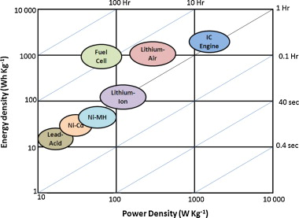
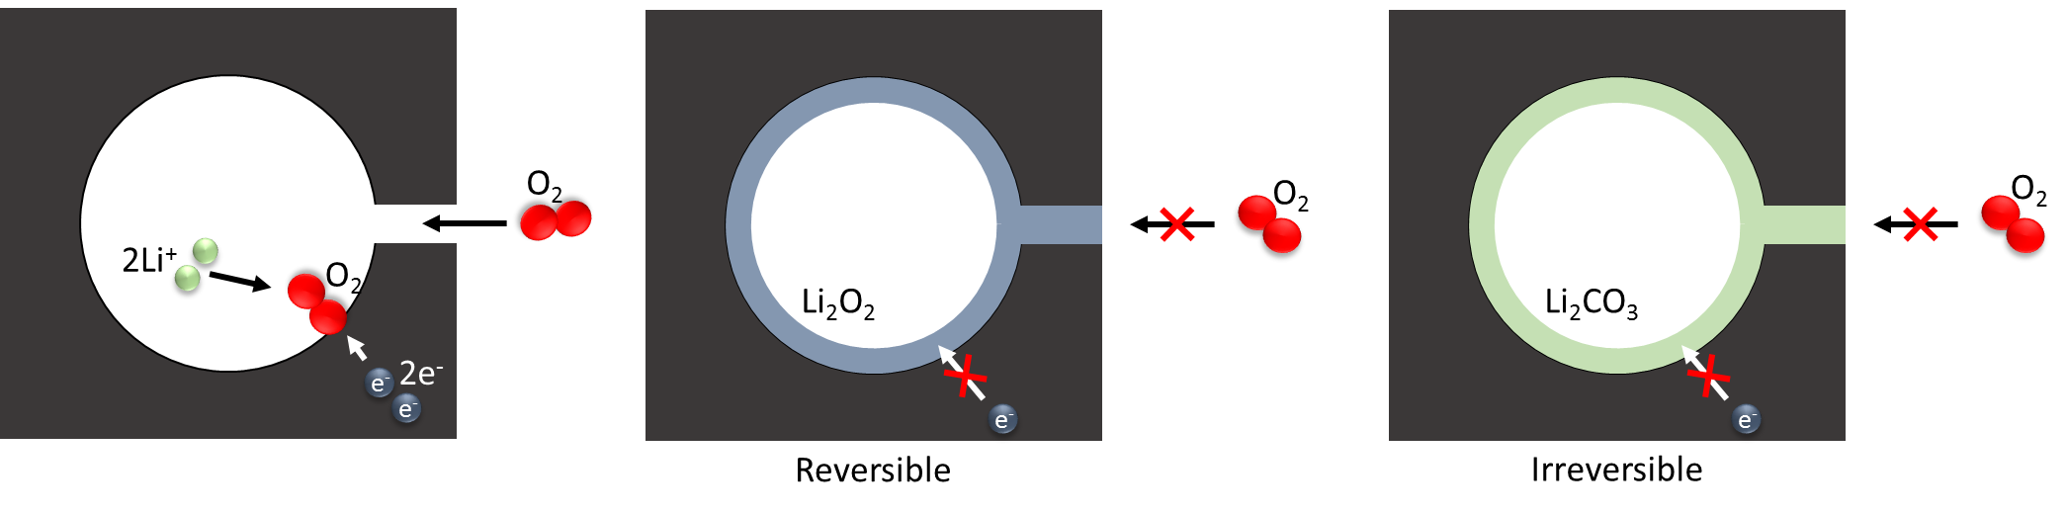
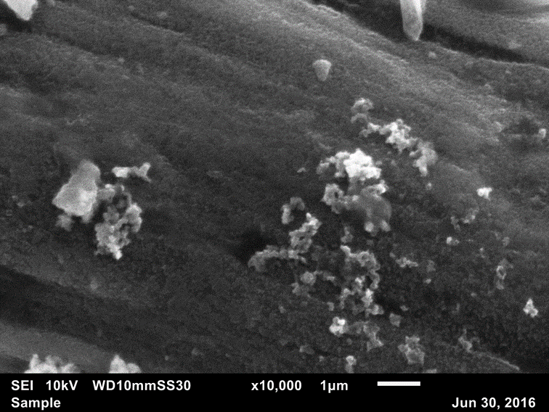
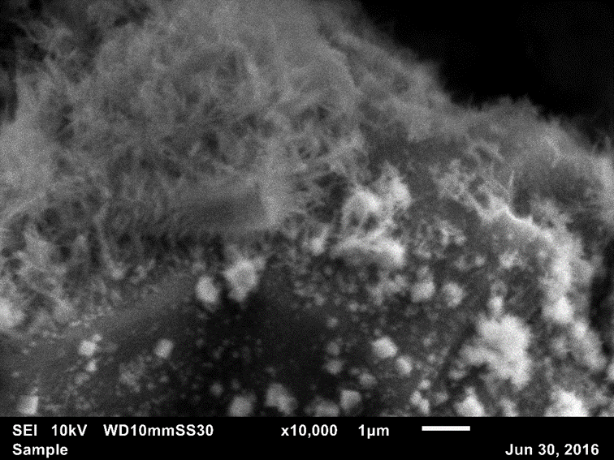
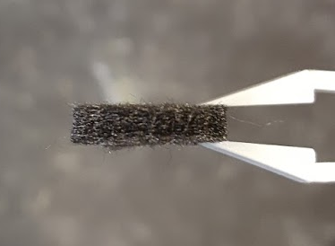
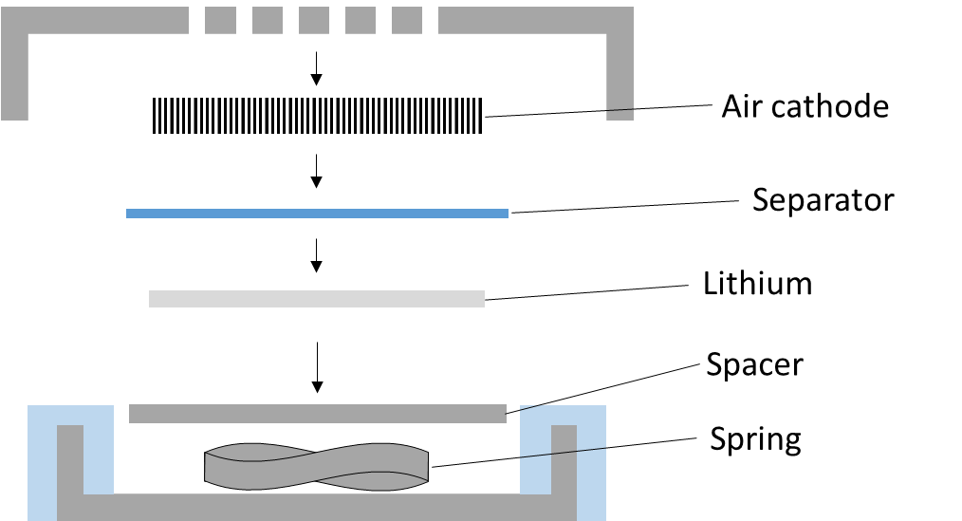
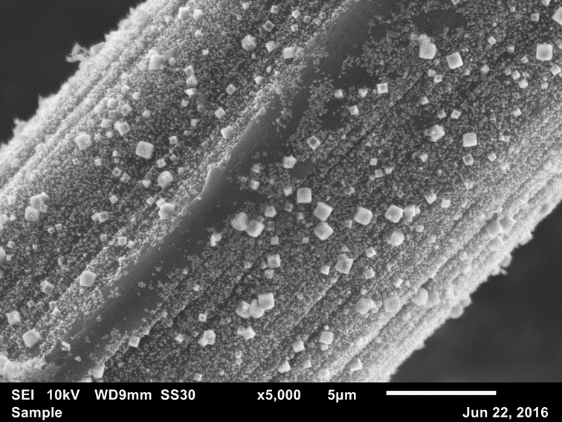
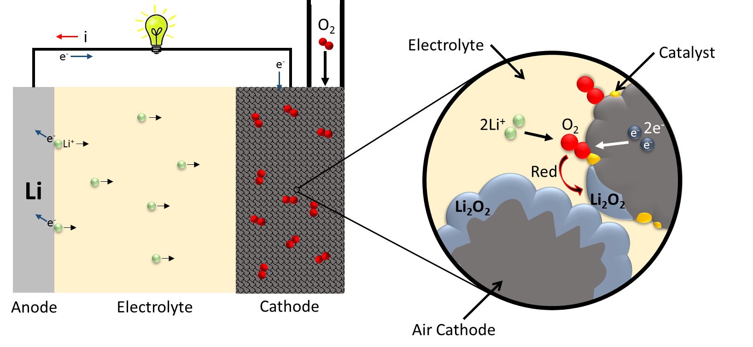
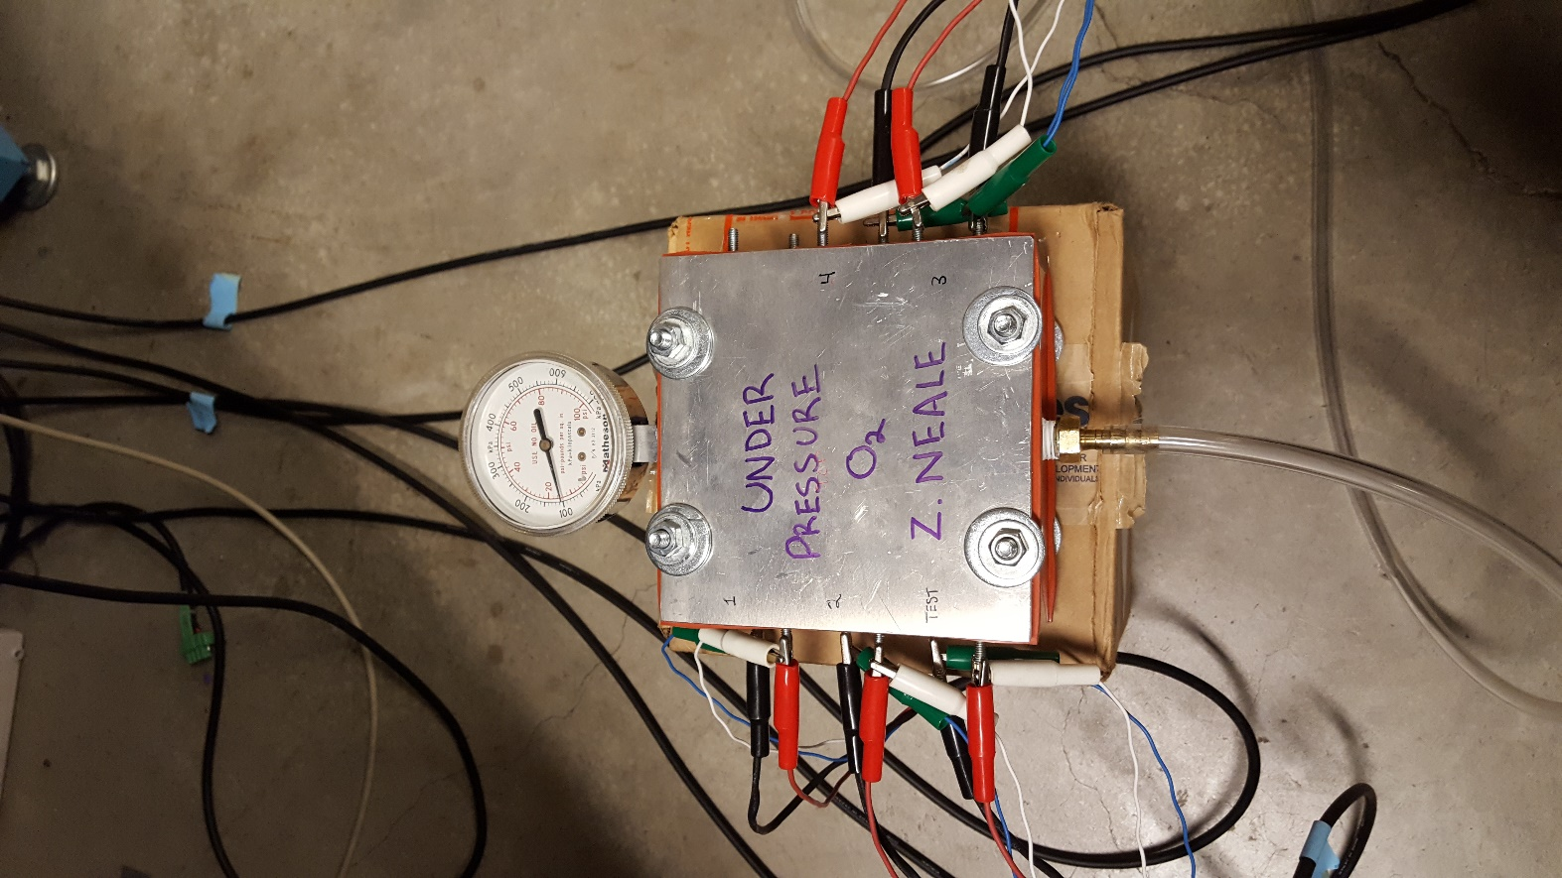


Hydrothermal Growth of Co₃O₄ Nanoparticles as Catalysts for Lithium-air Batteries
PI: Guozhong Cao
Author: Son Luong
Mentor: Zachary Neale
Background
Challenges
Methods
Results
Lithium-air batteries were first discovered in the 1970s and since then they have attracted a lot of attention from academia and research. They’re considered the future of energy storage science due to their extremely high theoretical energy density which is comparable to that of gasoline. The max energy density was calculated around ~12 kWh/kg which is close to the specific energy of gasoline (~13 kWh/kg).
The battery usually contains a lithium metal anode and open air cathode that will allow oxygen in the air get inside. Both are connected by a non-aqueous electrolyte to allow the transport of lithium ions. The mechanism behind the secondary Li-air battery is the oxygen reduction reaction (ORR) and oxygen evolution reaction (OER) at the tri-phase boundary between oxygen, lithium ions, and conductive air cathode. During discharge the lithium ions from the anode, dissolved oxygen in the electrolyte, along with two electrons from the cathode will react to produce lithium peroxide (Li₂O₂). The process will take the opposite direction and release oxygen when the battery is recharged.
$$2{Li}^{+}+2e^{−}+O_{2}↔Li_{2}O_{2} \left(Eo =2.96 V\right)$$
Practical Li-air cells suffer limited capacity, high overpotentials, and short cycle life due to factors including sluggish ORR and OER kinetics, insoluble discharge product, and decomposition of carbon cathode and electrolyte. The discharge product, lithium peroxide is also electrically insulating which passivates the cathode. Additionally, some carbon based cathodes and electrolytes can decompose into irreversible lithium carbonate that will lead to severe capacity fading. The insolubility of these products can clog pores, preventing further diffusion of lithium ions and oxygen.
Different air cathode materials and catalysts can help mitigate the addressed problems. The objective of the following research in progress is to investigate how the addition of catalytic Co₃O₄ nanoparticles grown on a carbon fiber cathode can improve its performance as an air cathode for Li-air batteries. Carbon fiber felt could be an optimal material for Li-air batteries due to its light weight, ease of manufacturability, and low cost. Its open structure can prevent clogging and allow for open diffusion of oxygen and lithium ions. Co₃O₄ is a well studied bifunctional catalyst for the ORR and OER due to its mixed valence spinel structure. The morphology of the catalyst can be adjusted through different synthesis techniques that can affect the performance of the cathode.
Synthesis of Co₃O₄: We are using the hydrothermal process to directly grow cobalt oxide nanostructures on pyrolyzed polyacrylonitrile (PAN) fibers. The process involves preparing a 0.05 M cobalt(II) nitrate precursor solution at a pH of 8. The solution’s pH is adjusted by adding ammonium hydroxide. The addition of hydroxide changes the color of the cobalt(II) nitrate solution from light red to blue, and also precipitated green particles after an hour of stirring. The color change is associated with the formation of insoluble cobalt hydroxide, which acts as the seed crystal for nanoparticle growth. Hydrothermal synthesis was performed with PAN felt submerged in the cobalt solution at 180ºC for 12 hours with a heating rate of 6ºC/min. After washing with water and allowing to dry, the sample is annealed at 350ºC for 2 hours in air. XRD characterization was performed on precipitated particles at the bottom of the hydrothermal crucible.
Electrochemical Testing: Li-air batteries using as-received PAN felt and Co₃O₄ grown on PAN felt (Co₃O₄@PAN) were made in an argon glove box using CR2032 coin cells modified for metal-air batteries. Glass fiber paper soaked in electrolyte was used to separate the lithium metal anode from air cathode. The electrolyte was 1M LiTFSI dissolved in TEGDME.
The Li-air batteries were tested in an air tight box under 1 atm 99.999% O₂ gas. The batteries were allowed to sit in oxygen for 10 hours before testing. Linear sweep voltammetry was done on the batteries at a rate of 0.5 mV/s from 3.1 and 1.8 V for the cathodic sweep and between 2.9 and 4.05 V for the anodic sweep. The batteries were held at 2.5 V for one hour before the anodic sweep. Galvanostatic cycling was performed at a current rate of 0.02 mA/cm². The cycled batteries were opened in air and rinsed with acetonitrile in order to perform SEM.
Co₃O₄
Figure 7: XRD result from the hydrothermal process
Figure 3: Clogging of porous cathode material by formation of insoluble Li₂O₂ and Li₂CO₃.
7.5 days
8.7 days
Objective
Figure 8: Linear sweep voltammetry (left) and galvanostatic cycling (right).
Figure 1: Li-air energy and power density compared with other systems.
Figure 9: SEM micrographs of plain PAN (left) and Co₃O₄@PAN (right) air cathodes after galvanostatic cycling.
Discussion
Hydrothermal synthesis resulted in pure phase Co₃O₄ with no CoO or Co(OH)₂ impurity phases according to XRD. The addition of Co₃O₄ nanoparticles decreased the overpotential of the ORR by 79 mV determined by the shift in voltage peak of the cathodic linear sweep. The carbon cathode with Co₃O₄ particles had over 553 mAh/g higher capacity than the plain PAN felt cathode. SEM showed that discharge product formed nanowires on Co₃O₄ particles in comparison to smaller rough particles coating the surface of plain PAN felt. The increased capacity could be attributed to the increased packing density of nanowire growth promoted by the Co₃O₄ catalyst. The modest current rate used resulted in prolonged testing over 7 days. In this time there could be significant loss of electrolyte through evaporation which could explain the smaller charge capacities and their similarity between the two batteries. Otherwise, charge capacity could be lost due to the formation of Li₂CO₃ product which is common among carbon based cathodes. Further compositional analysis must be performed to validate these conclusions.
Figure 5: PAN carbon felt (left) and coin cell assembly (right).
Figure 2: Schematic of Li-air battery during discharge.
Figure 4: Co₃O₄ at PAN carbon fiber.
Figure 6: Air-tight box for Li-air battery testing.
This project was supported by the Clean Energy Institute, Undergraduate Research Program, and Professor Guozhong Cao's Research Group at the University of Washington.
Special thanks to my mentors Mr. Zachary Neale and Dr. Guozhong Cao.

