Slide 1
Thermal Stability of LiCoO₂ and Garnet Solid Electrolyte Li₇La₃Zr₂O₁₂

Slide 2
Outline
Introduction/Background
Experimental Process
Results
Conclusion

Slide 3
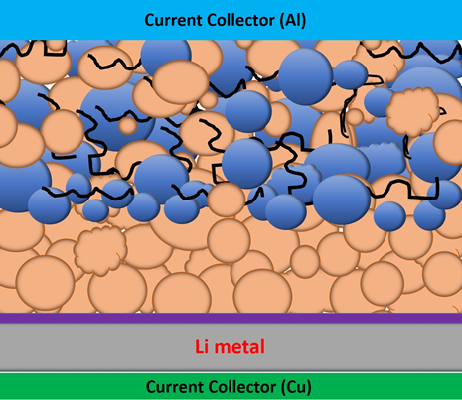
Motivation
To better understand the thermal
stability of the LCO and LLZO composite
Decrease the interfacial impedances

Slide 4
Solid State Electrolytes
Solid superionic conducting material
Replaces traditional liquid electrolyte
Creates a strong ionic bridge between cathode and anode

Slide 5
Benefits
Safety
  Boeing 787, Tesla Model S, Cell Phones, Laptops, Etc
Increased Power Density
  More battery life and charge cycles
Degeneration
  Can last thousands of years
Temperature Stability

Slide 6
Cons
Cost to Produce
  Rare materials – Ex. Germanium
  Lengthy, in depth production methods
Interface Impedences
  Poor cycle stability
  Poor rate capability
Currently Unrealistic Applications
  Ex. Lithium-Air

Slide 7
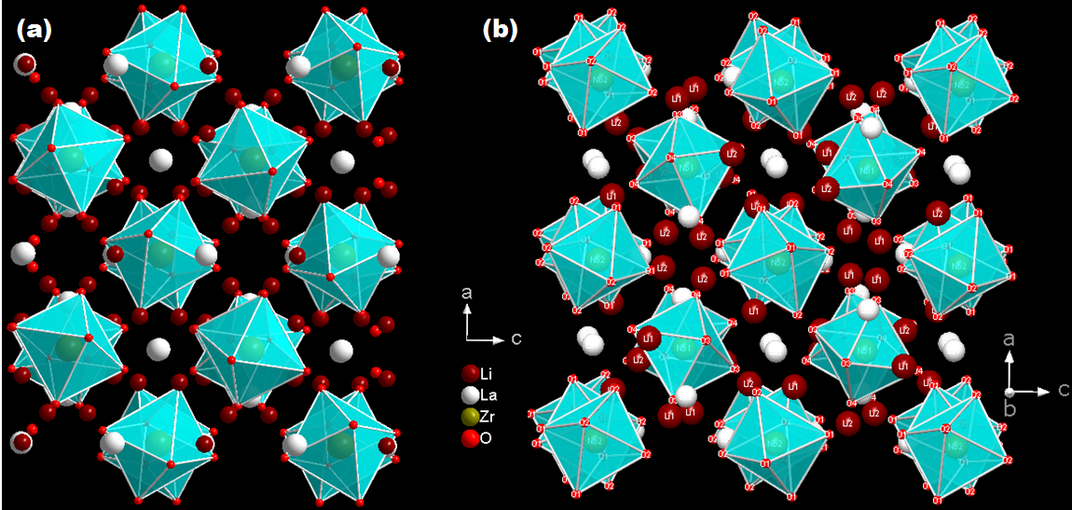
My Research
Different Lithium Lanthanum
Zirconium Oxide States
  Cubic
  Tetragonal
X-Ray Diffraction (XRD)
Electrochemical Impedance Spectroscopy (EIS)
Differential Scanning Calorimetry (DSC)

Slide 8
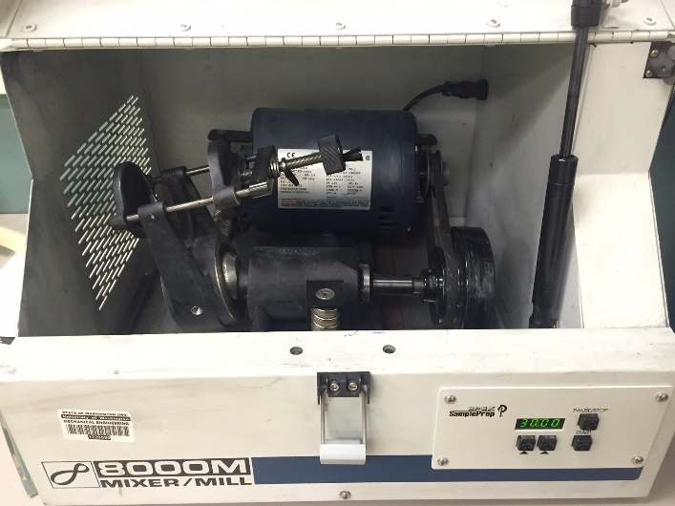
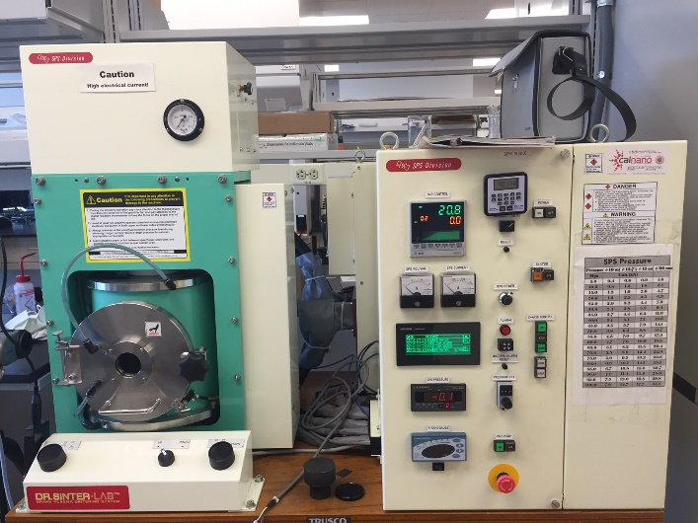
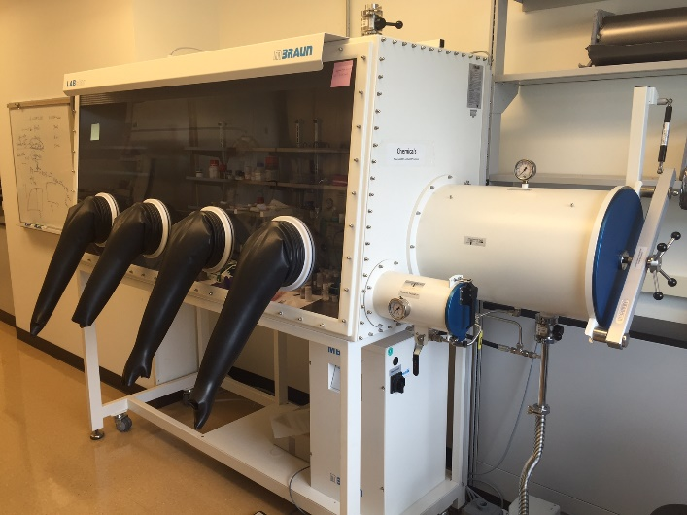
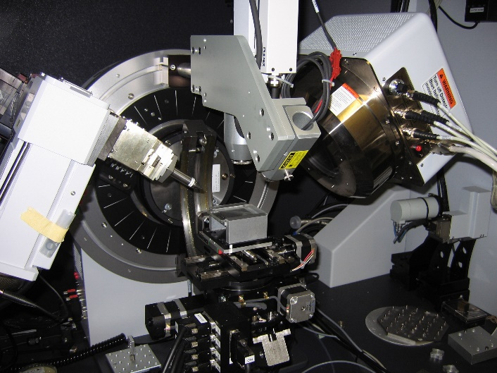
Material Fabrication
Initial LLZO mixing
  Cubic doped with aluminum
  Ball Mill
Cold Press and Heat Sample
Grind and Store in Glove Box
Spark Plasma Sintering (SPS), XRD, Furnace Sintering

Slide 9
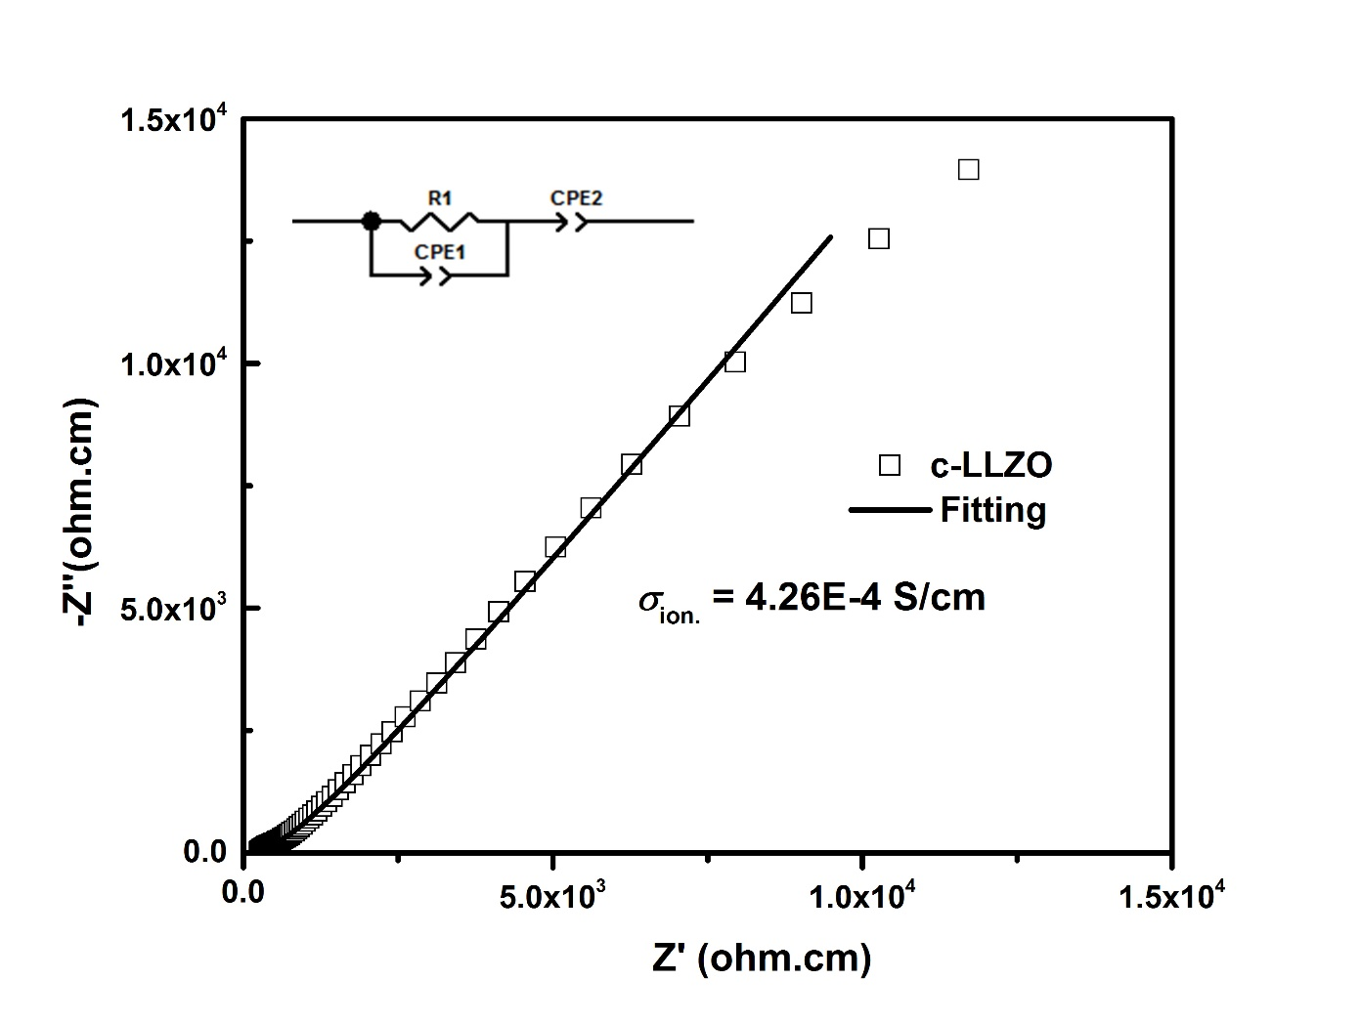
Cubic LLZO Electrochemical Impedance Spectroscopy

Slide 10
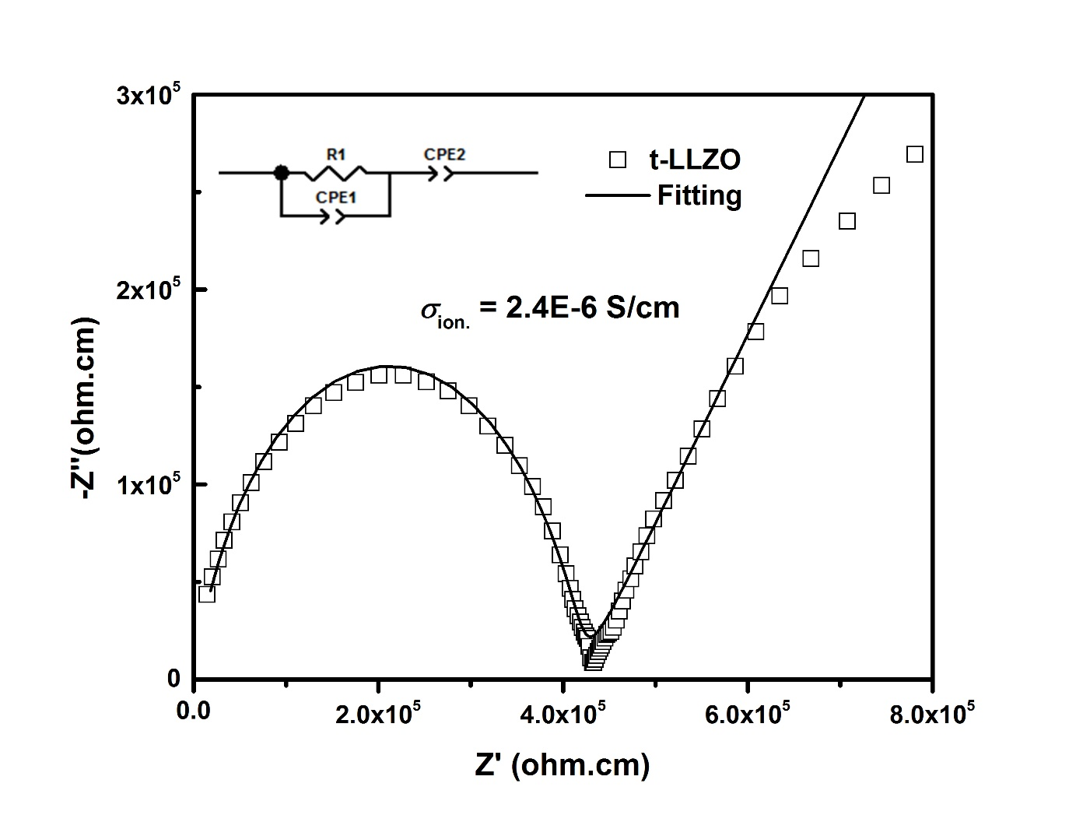
Tetragonal LLZO Electrochemical Impedance Spectroscopy

Slide 11
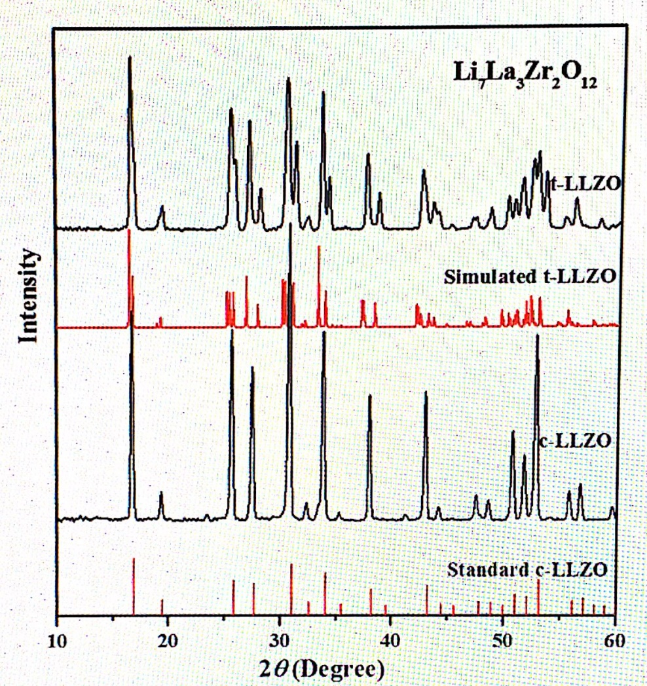
XRD of Pure c-LLZO and t-LLZO

Slide 12
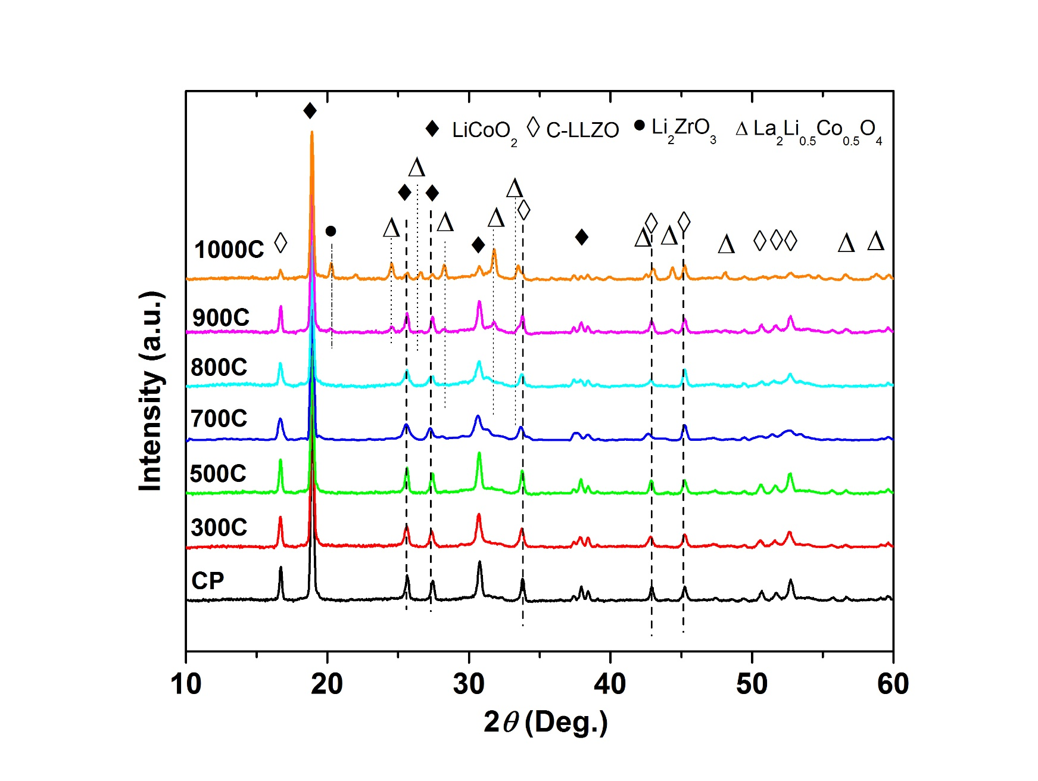
XRD Analysis of Cubic Phase LLZO - LCO

Slide 13
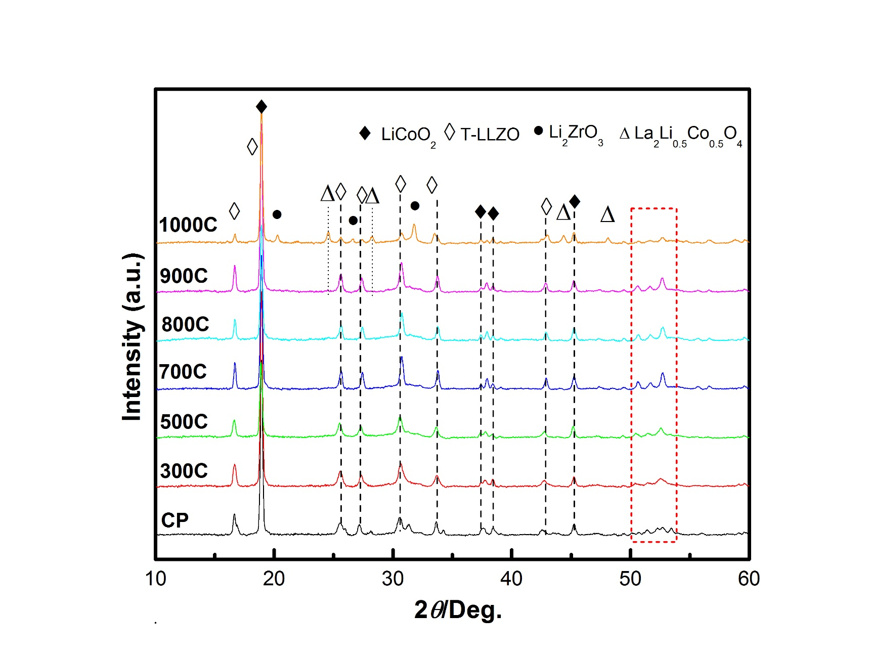
XRD Analysis of Tetragonal Phase LLZO - LCO

Slide 14
Cubic Differential Scanning Calorimetry
H₂O
LiOH
LiZrO and LaLiCoO

Slide 15
Tetragonal Differential Scanning Calorimetry
H₂O
LiOH
LiZrO and LaLiCoO
Lithium Vaporization

Slide 16
Conclusion
Cubic LLZO is not thermally stable enough to undergo sintering
Different methods should be considered
LCO and c-LLZO could still be good product despite impurities
  Impurities may have minimal effect
  Needs further research

Slide 17
Thank you for your time!

