Slide 1

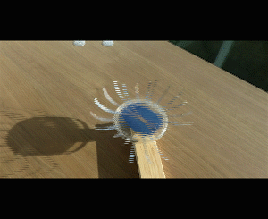
Solar Spinner
Demonstrates the conversion of solar energy into electricity and then mechanical energy

Slide 2
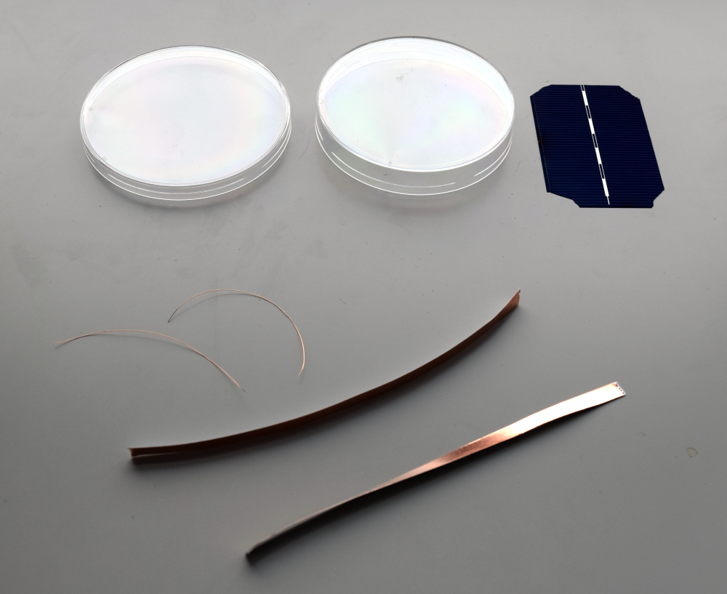
Solar cell (very brittle)
100 mm plastic petri dish
¼ “ adhesive conductive copper foil

Slide 3
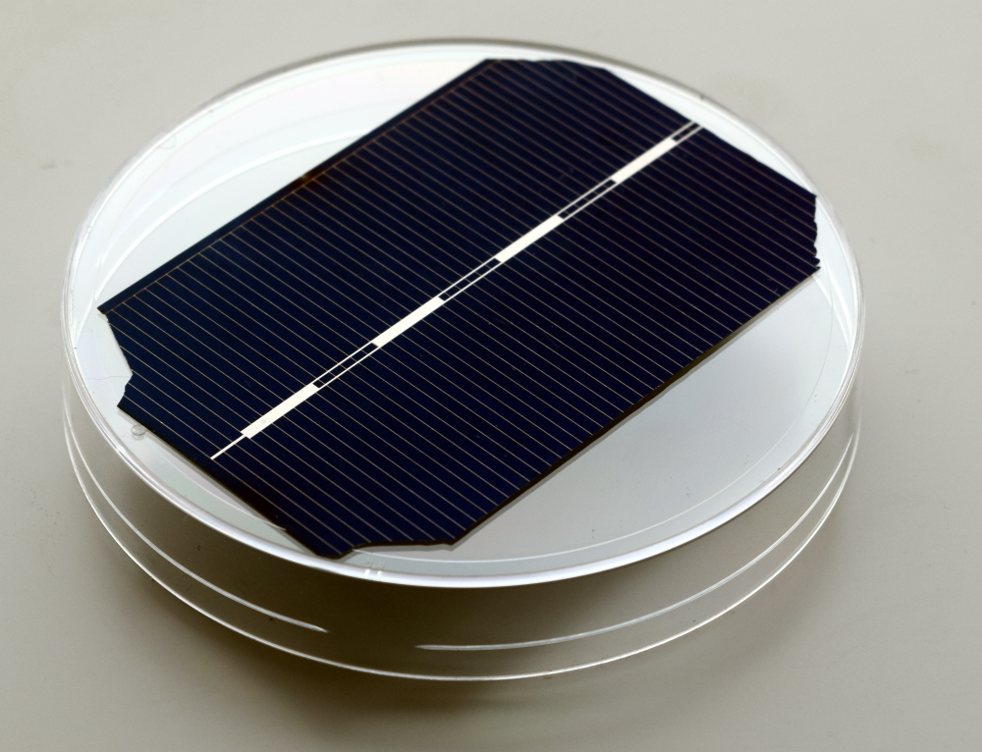
Corners of solar cell are clipped so it fits on bottom of smaller petri dish

Slide 4
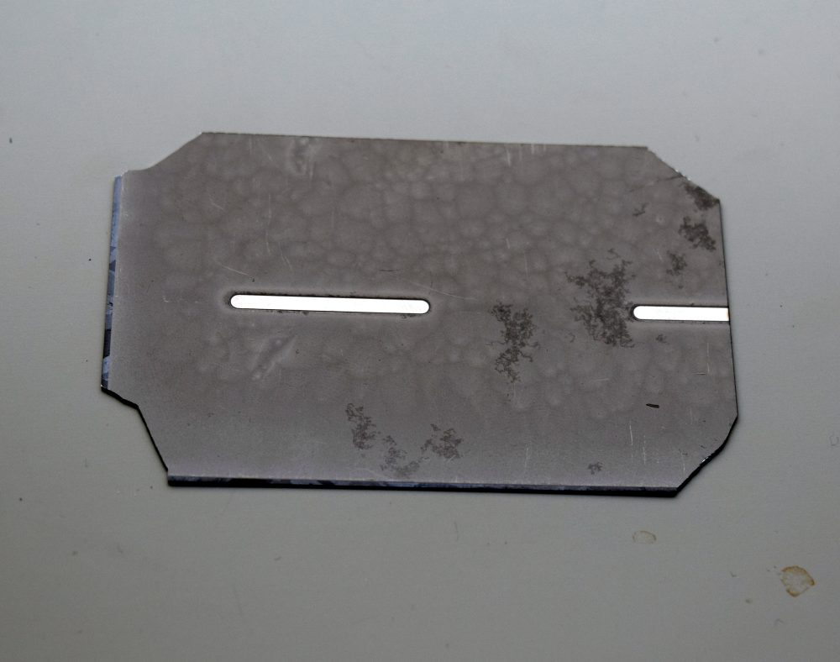
Back of solar cell with silver contact strips- collects positive charge
Position of copper tape

Slide 5
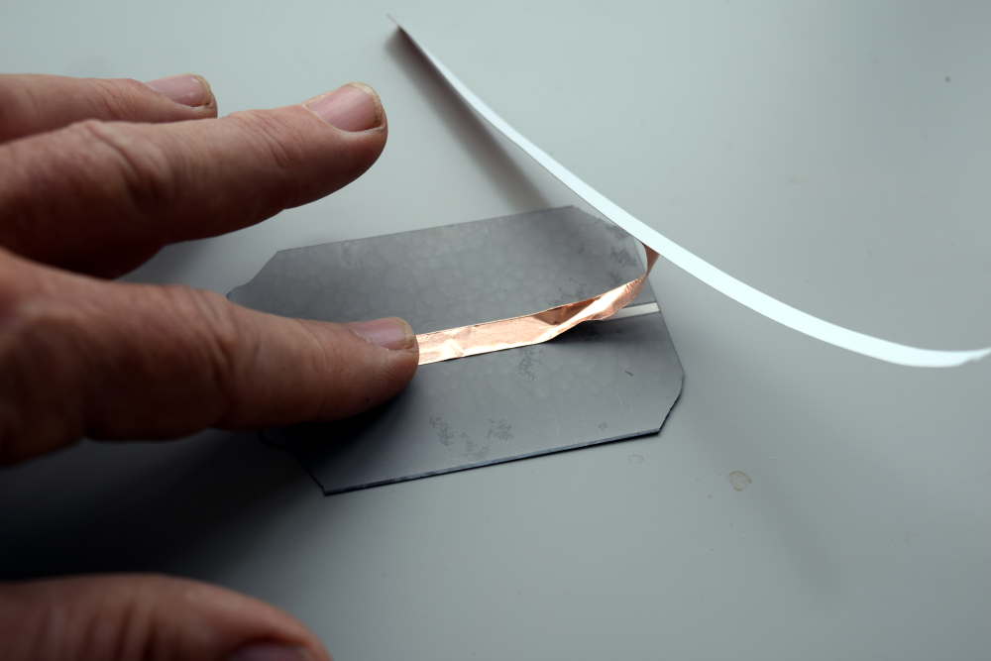
Partially remove tape backing-
gently press on back contact starting 1” from edge
Solar cell must be flat on table

Slide 6
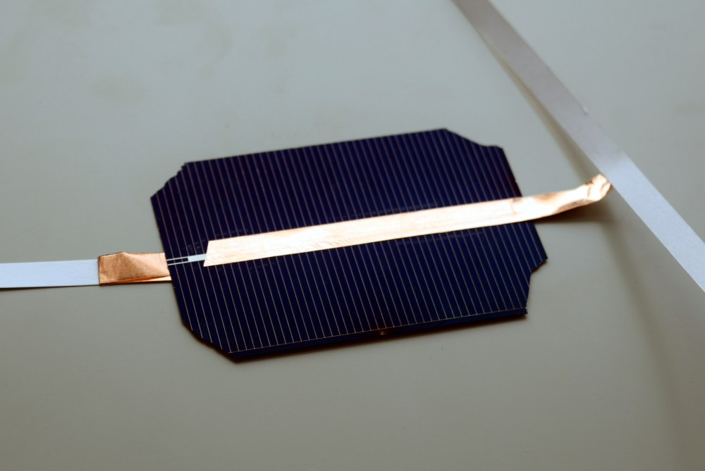
Top of cell collects the negative charge
Copper strip covers the silver strip starting ½” from edge of the cell.
Don’t let the front and back contact strips touch = short circuit

Slide 7
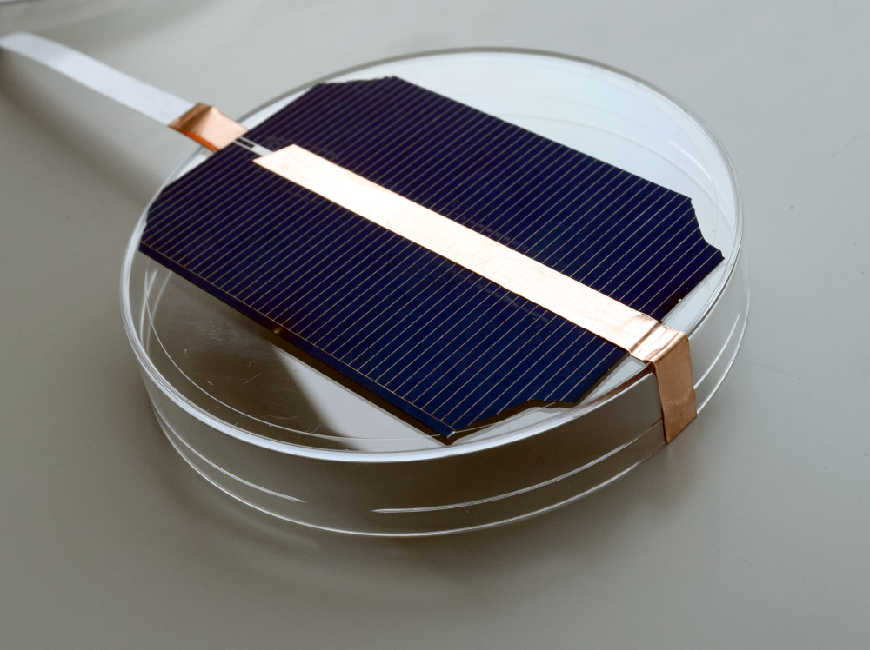
Wrap top contact over and around edge of petri dish

Slide 8
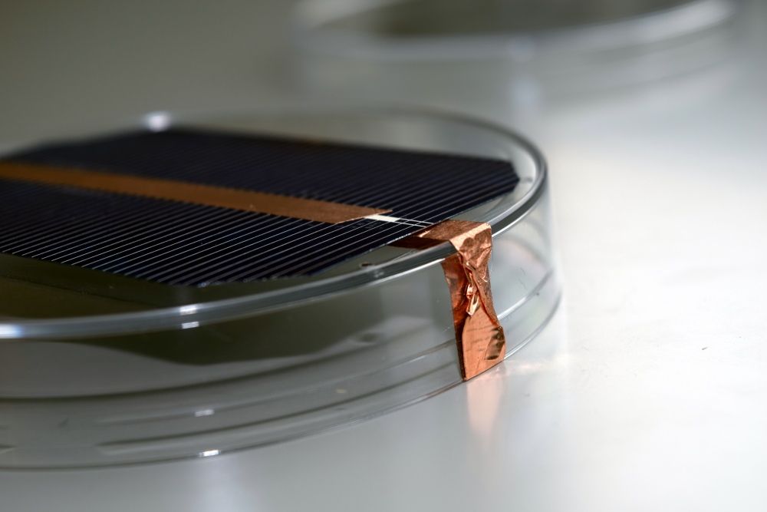
Fold bottom strip over on itself so sticky side touches dish,
wrap around edge of petri dish

Slide 9
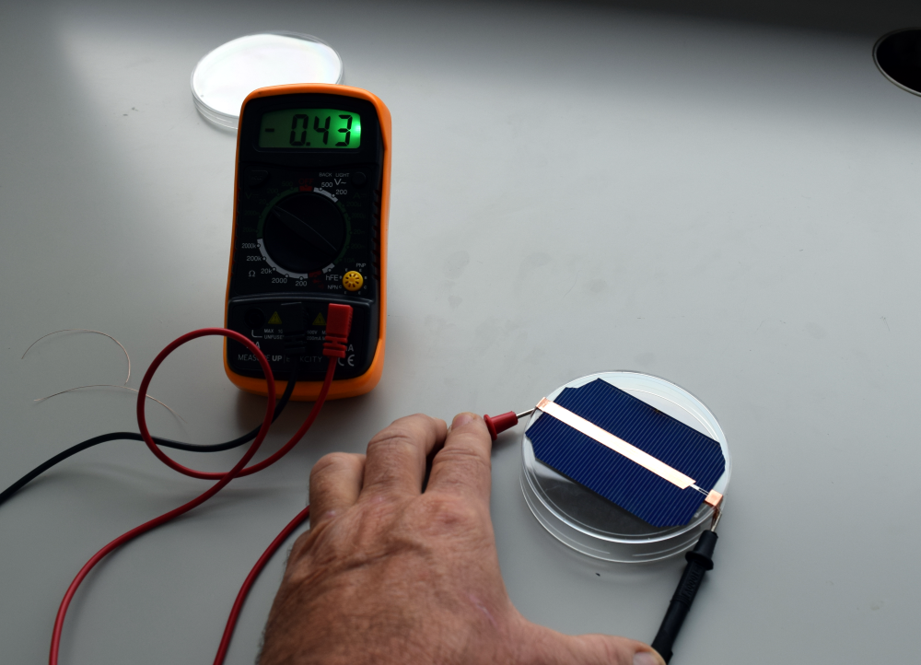
Test the voltage of the cell on the 2 volt
range, to make sure it is connected
correctly- .3-.55 volts

Slide 10
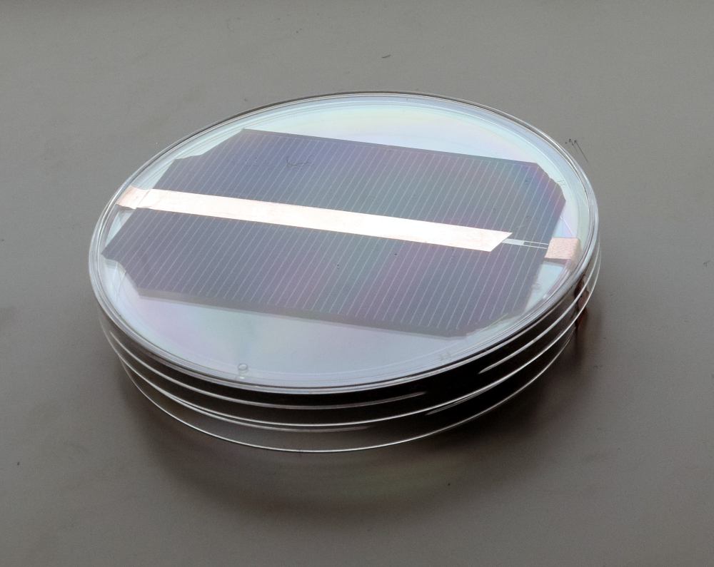
Place the petri dish cover and secure with 2 pieces of clear plastic tape.

Slide 11
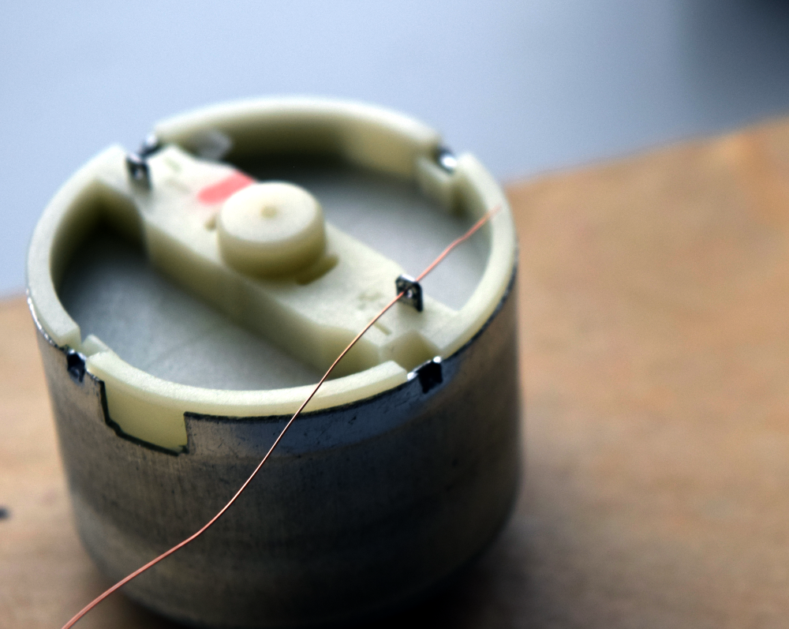
Thread thin copper wire through the lugs on the back of the motor
and bend over about ¼”

Slide 12
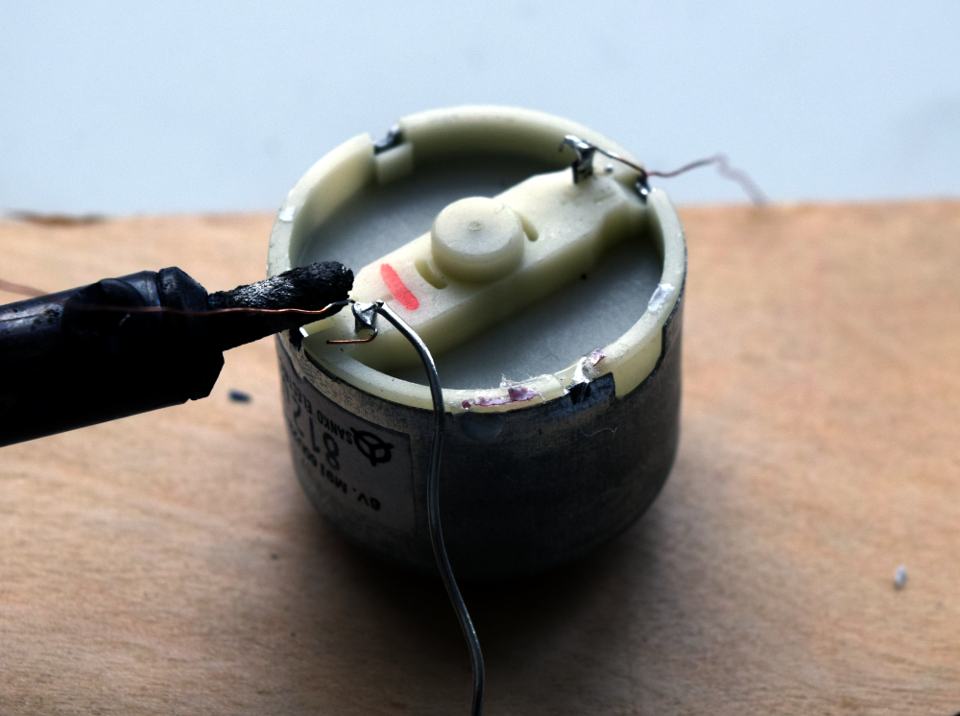
Solder the copper wire to each lug.

Slide 13
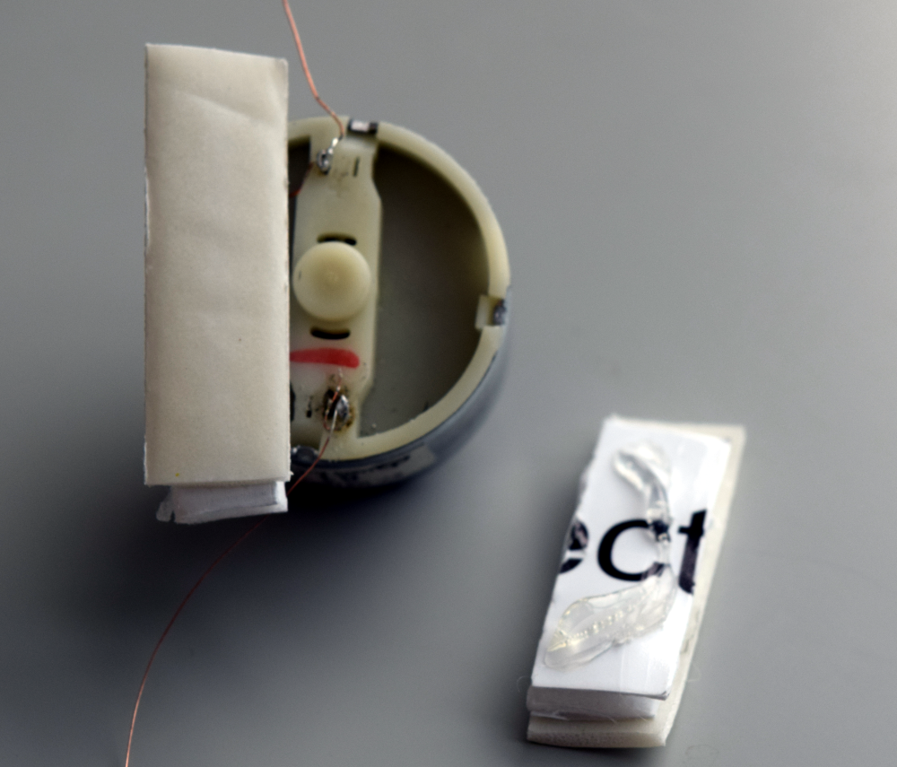
Hot glue two spacer strips to the back of the motor
And add a piece of foam tape to each.
Foam tape
Hot glue

Slide 14
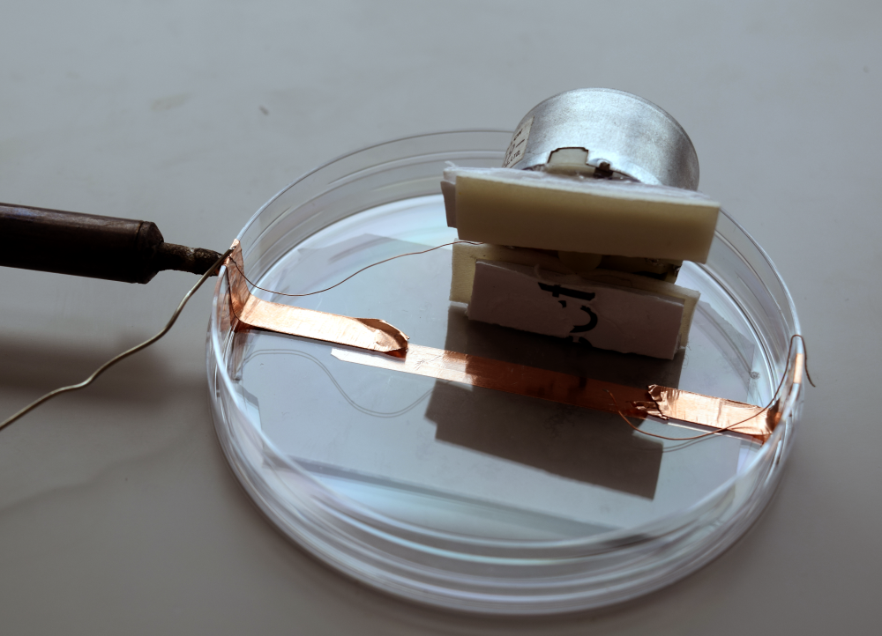
Solder motor wires to the copper strips coming from the solar cell.
Test the motor to see that it is turning in the light.

Slide 15
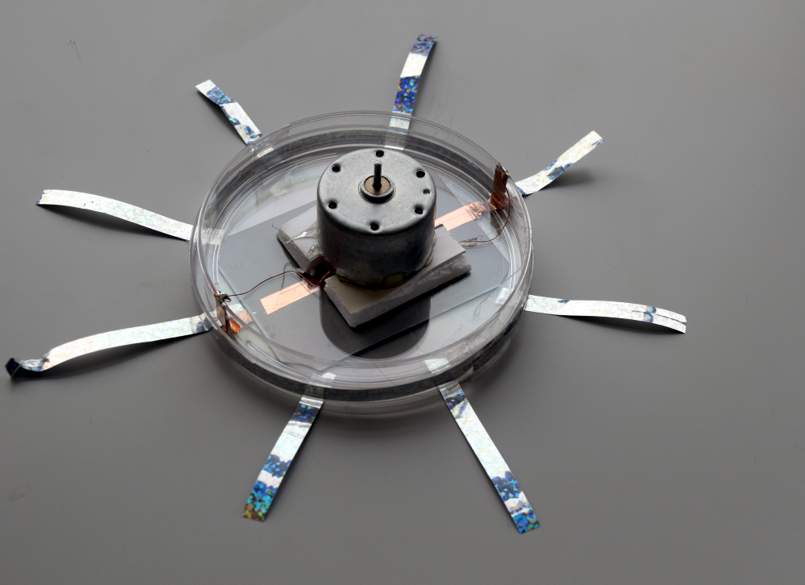
Peel off backer on foam tape-
carefully center the motor on the dish, press down.

Slide 16
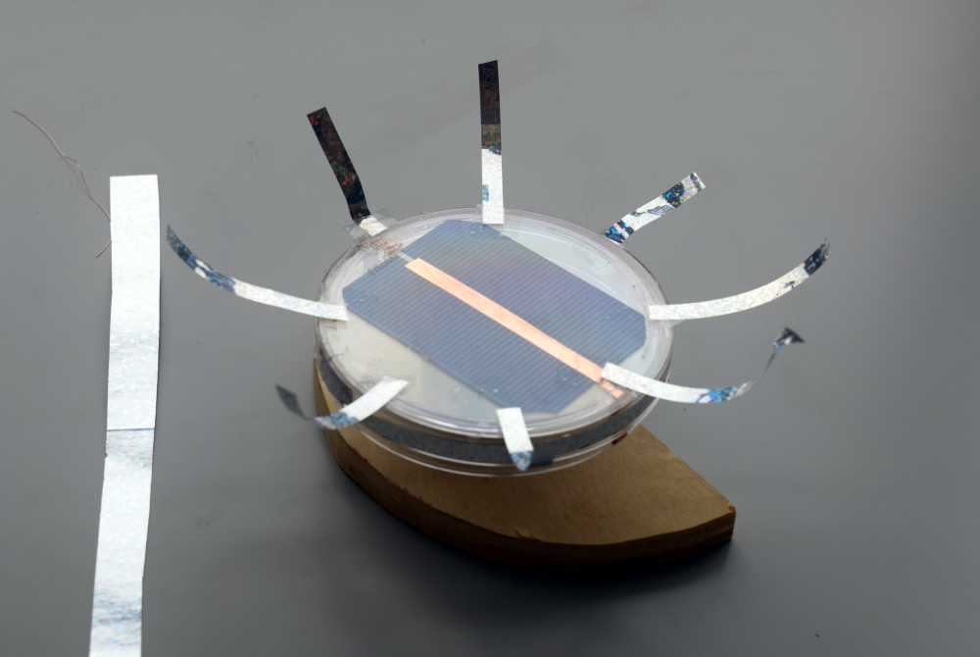
Decorate your Solar Spinner

Slide 17
Mount the spinner on a block of wood or stick with a hole drilled to fit the shaft. Put the solar spinner in your yard or sunny window. What other creations can you make with this as a starting point?

Slide 18
Make more at your school
Amazon-
Copper tape
Petri dishes
Copper wire
Ebay – solar cells $.50 each
Electronics Goldmine- high efficiency motor- $1.50
http://cei.washington.edu/education/lessons

