Slide 1
Make Your Own Berry-Sensitized Solar Cell!
[Insert presenter names here]

Slide 2
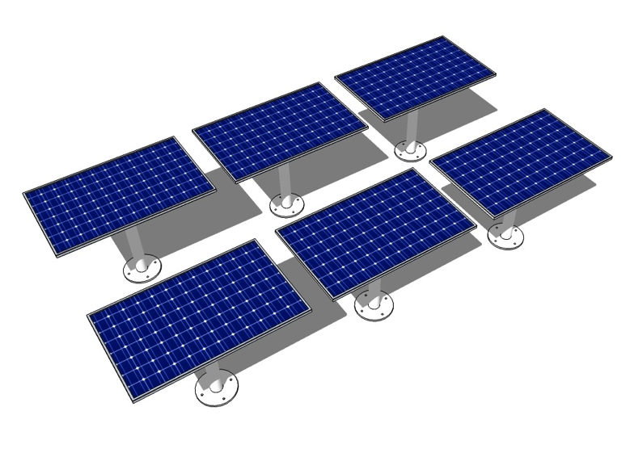
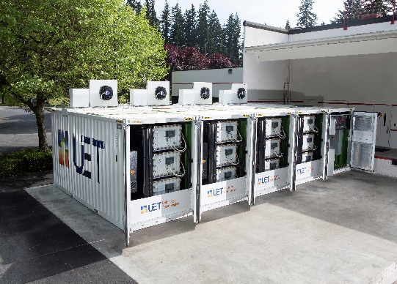
CEI Mission
Accelerate a scalable clean energy future through scientific and technological advances in
+ +
solar storage grid
Notes:
Today we’ll be focusing on solar energy, but there are so many areas that need research and innovation!

Slide 3
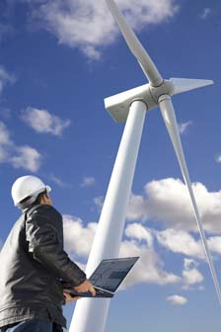
Research Careers
Clean Energy Careers
Years after
School
Bachelors
Master Degree- 1-2 years
Graduate student is paid to do research in a group led by a faculty (Principle investigator)5-6 yearssome courses, original research, thesis
Post Doc –1-2 year terms at different universities
Ph.D. can become faculty, principle investigator researcher, industry
Associates Degree- Community College
Opportunities
Technician- solar installer, designer
Wind turbine mechanic
Industrial research, business, startups
Teaching at Community Colleges
Faculty- research and teaching at University
Patents
Government Labs
2
4
5-6
8-10
10-15

Slide 4
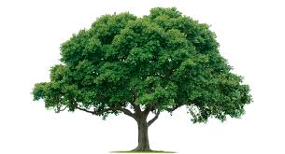
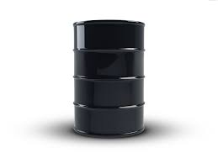
Energy Conversion Pathways

Slide 5
Energy Conversion Pathways

Slide 6
Dye-Sensitized Solar Cell
Components:
Transparent anode
Collect negative charges
TiO₂ support
Transport negative charges
Dye
Absorb sunlight
Electrolyte solution
Regenerate dye
Transport positive charges
Cathode
Collect positive charges

Slide 7
Harnessing light through an energy cascade
E
Anode
TiO₂
Dye
3I⁻/I₃⁻
Cathode

Slide 8
Harnessing light through an energy cascade
E
+
Anode
TiO₂
Dye
3I⁻/I₃⁻
Cathode

Slide 9
Harnessing light through an energy cascade
E
I⁻
⅓ I₃⁻
+
Anode
TiO₂
Dye
3I⁻/I₃⁻
Cathode

Slide 10
Harnessing light through an energy cascade
E
I⁻
+
⅓ I₃⁻
Anode
TiO₂
Dye
3I⁻/I₃⁻
Cathode

Slide 11
Harnessing light through an energy cascade
E
I⁻
+
⅓ I₃⁻
Anode
TiO₂
Dye
3I⁻/I₃⁻
Cathode

Slide 12
Harnessing light through an energy cascade
E
I⁻
+
⅓ I₃⁻
Anode
TiO₂
Dye
3I⁻/I₃⁻
Cathode

Slide 13
Harnessing light through an energy cascade
E
I⁻
+
⅓ I₃⁻
Anode
TiO₂
Dye
3I⁻/I₃⁻
Cathode

Slide 14
Harnessing light through an energy cascade
Electron (-) flow
E
Hole (+) flow
I⁻
+
⅓ I₃⁻
Anode
TiO₂
Dye
3I⁻/I₃⁻
Cathode

Slide 15
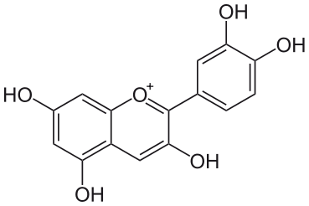
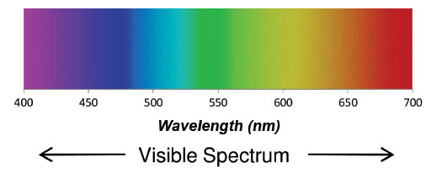
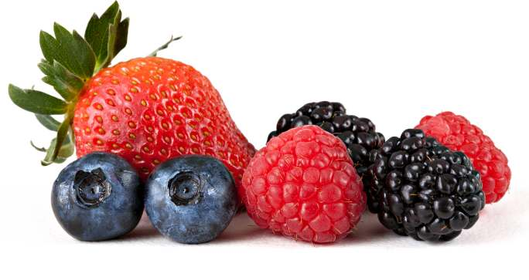
Choosing a Dye
Absorb Light
Looks red/purple because it absorbs green/yellow!
Cyanidin
https://www.orcagrowfilm.com
Notes:
Cyanidin is found in cherries, blackberries, blueberries, rasperrries etc. Anthocyanin is the class of molecules containing the absorbing structure highlighted in red

Slide 16
Choosing a Dye
Absorb Light
Looks red/purple because it absorbs green/yellow!
Chelates to TiO₂
The more oxygens the better!
Ti
Chelation: Bonding to a metal center through 2 or more points
Notes:
Cyanidin is found in cherries, blackberries, blueberries, rasperrries etc. Anthocyanin is the class of molecules containing the absorbing structure highlighted in red

Slide 17
Choosing a Dye
Absorb Light
Looks red because it absorbs green!
Chelates to TiO₂
The more oxygens the better!
Ti
Chelation: Bonding to a metal center through 2 or more points
Notes:
Cyanidin is found in cherries, blackberries, blueberries, rasperrries etc. Anthocyanin is the class of molecules containing the absorbing structure highlighted in red

Slide 18
Time to Make One!
Grab a TiO₂ slide

Slide 19
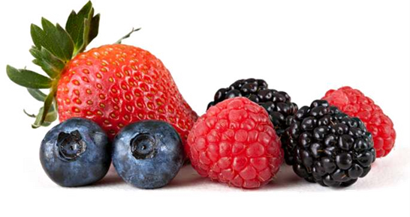
Time to Make One!
Grab a TiO₂ slide
Mash up some berries with some water

Slide 20
Time to Make One!
Grab a TiO₂ slide
Mash up some berries with some water
Soak TiO₂ slide in berry juice

Slide 21
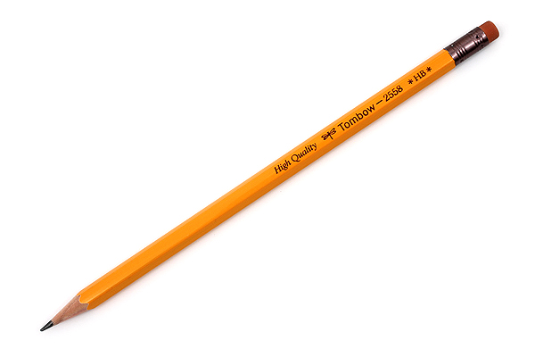
Time to Make One!
Grab a TiO₂ slide
Mash up some berries with some water
Soak TiO₂ slide
Carbon coat second electrode (with a pencil)

Slide 22
Time to Make One!
Grab a TiO₂ slide
Mash up some berries with some water
Soak TiO₂ slide
Carbon coat second electrode (with a pencil)
Put it all together

Slide 23
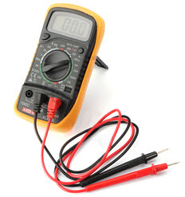
Time to Make One!
Grab a TiO₂ slide
Mash up some berries with some water
Soak TiO₂ slide
Carbon coat second electrode (with a pencil)
Put it all together
Test it!
Write down current (A) and voltage (V)

